Slide 1
Planning + Innovation BOD update
May 21, 2026

Slide 2
P+I Updates
New Projects:
  Woodward Corridor Modernization
    Thriving Communities Subawards
Grants and National Transit Database (NTD)
And More:
  Community Engagement Calendar
  Celebrating KC's and Drue's graduations!
Active Projects:
  Highway Express Bus Planning
  Access to Transit Program
  Mobility Wallet Pilot
  Mobility for All – Mobility Management
  Transit app

Slide 3
Active Projects

Slide 4
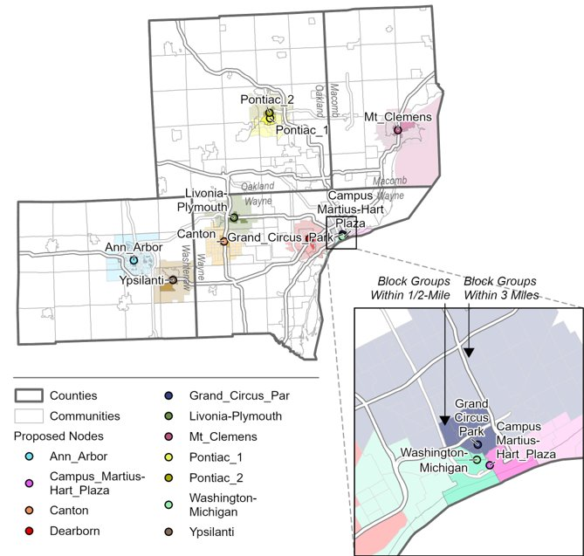
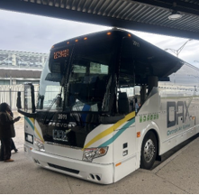
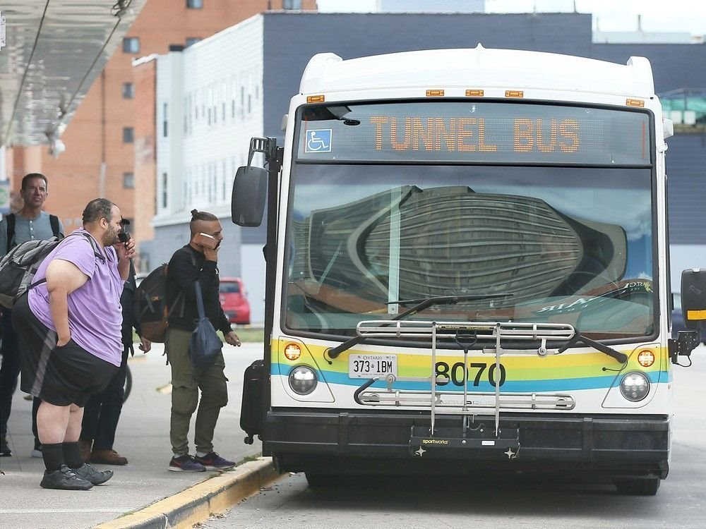
Highway Express Bus (HEB)
Goal: Evaluate expanded regional highway express bus service. Which complements local and limited-stop provider bus service by leveraging highway infrastructure – including shoulders or HOV lanes – to provide fast, convenient transit connections across the region.
Timeframe: March – September 2026
Tasks:
  A quantitative travel demand analysis to identify potential new highway express bus routes and park and ride locations, based on travel patterns in the region
  A performance evaluation of the Detroit Airport Express (DAX) service to date and an exploration of potential DAX service improvements
  Recommendations for feasible and effective capital investments to facilitate highway express bus service across the region

Slide 5
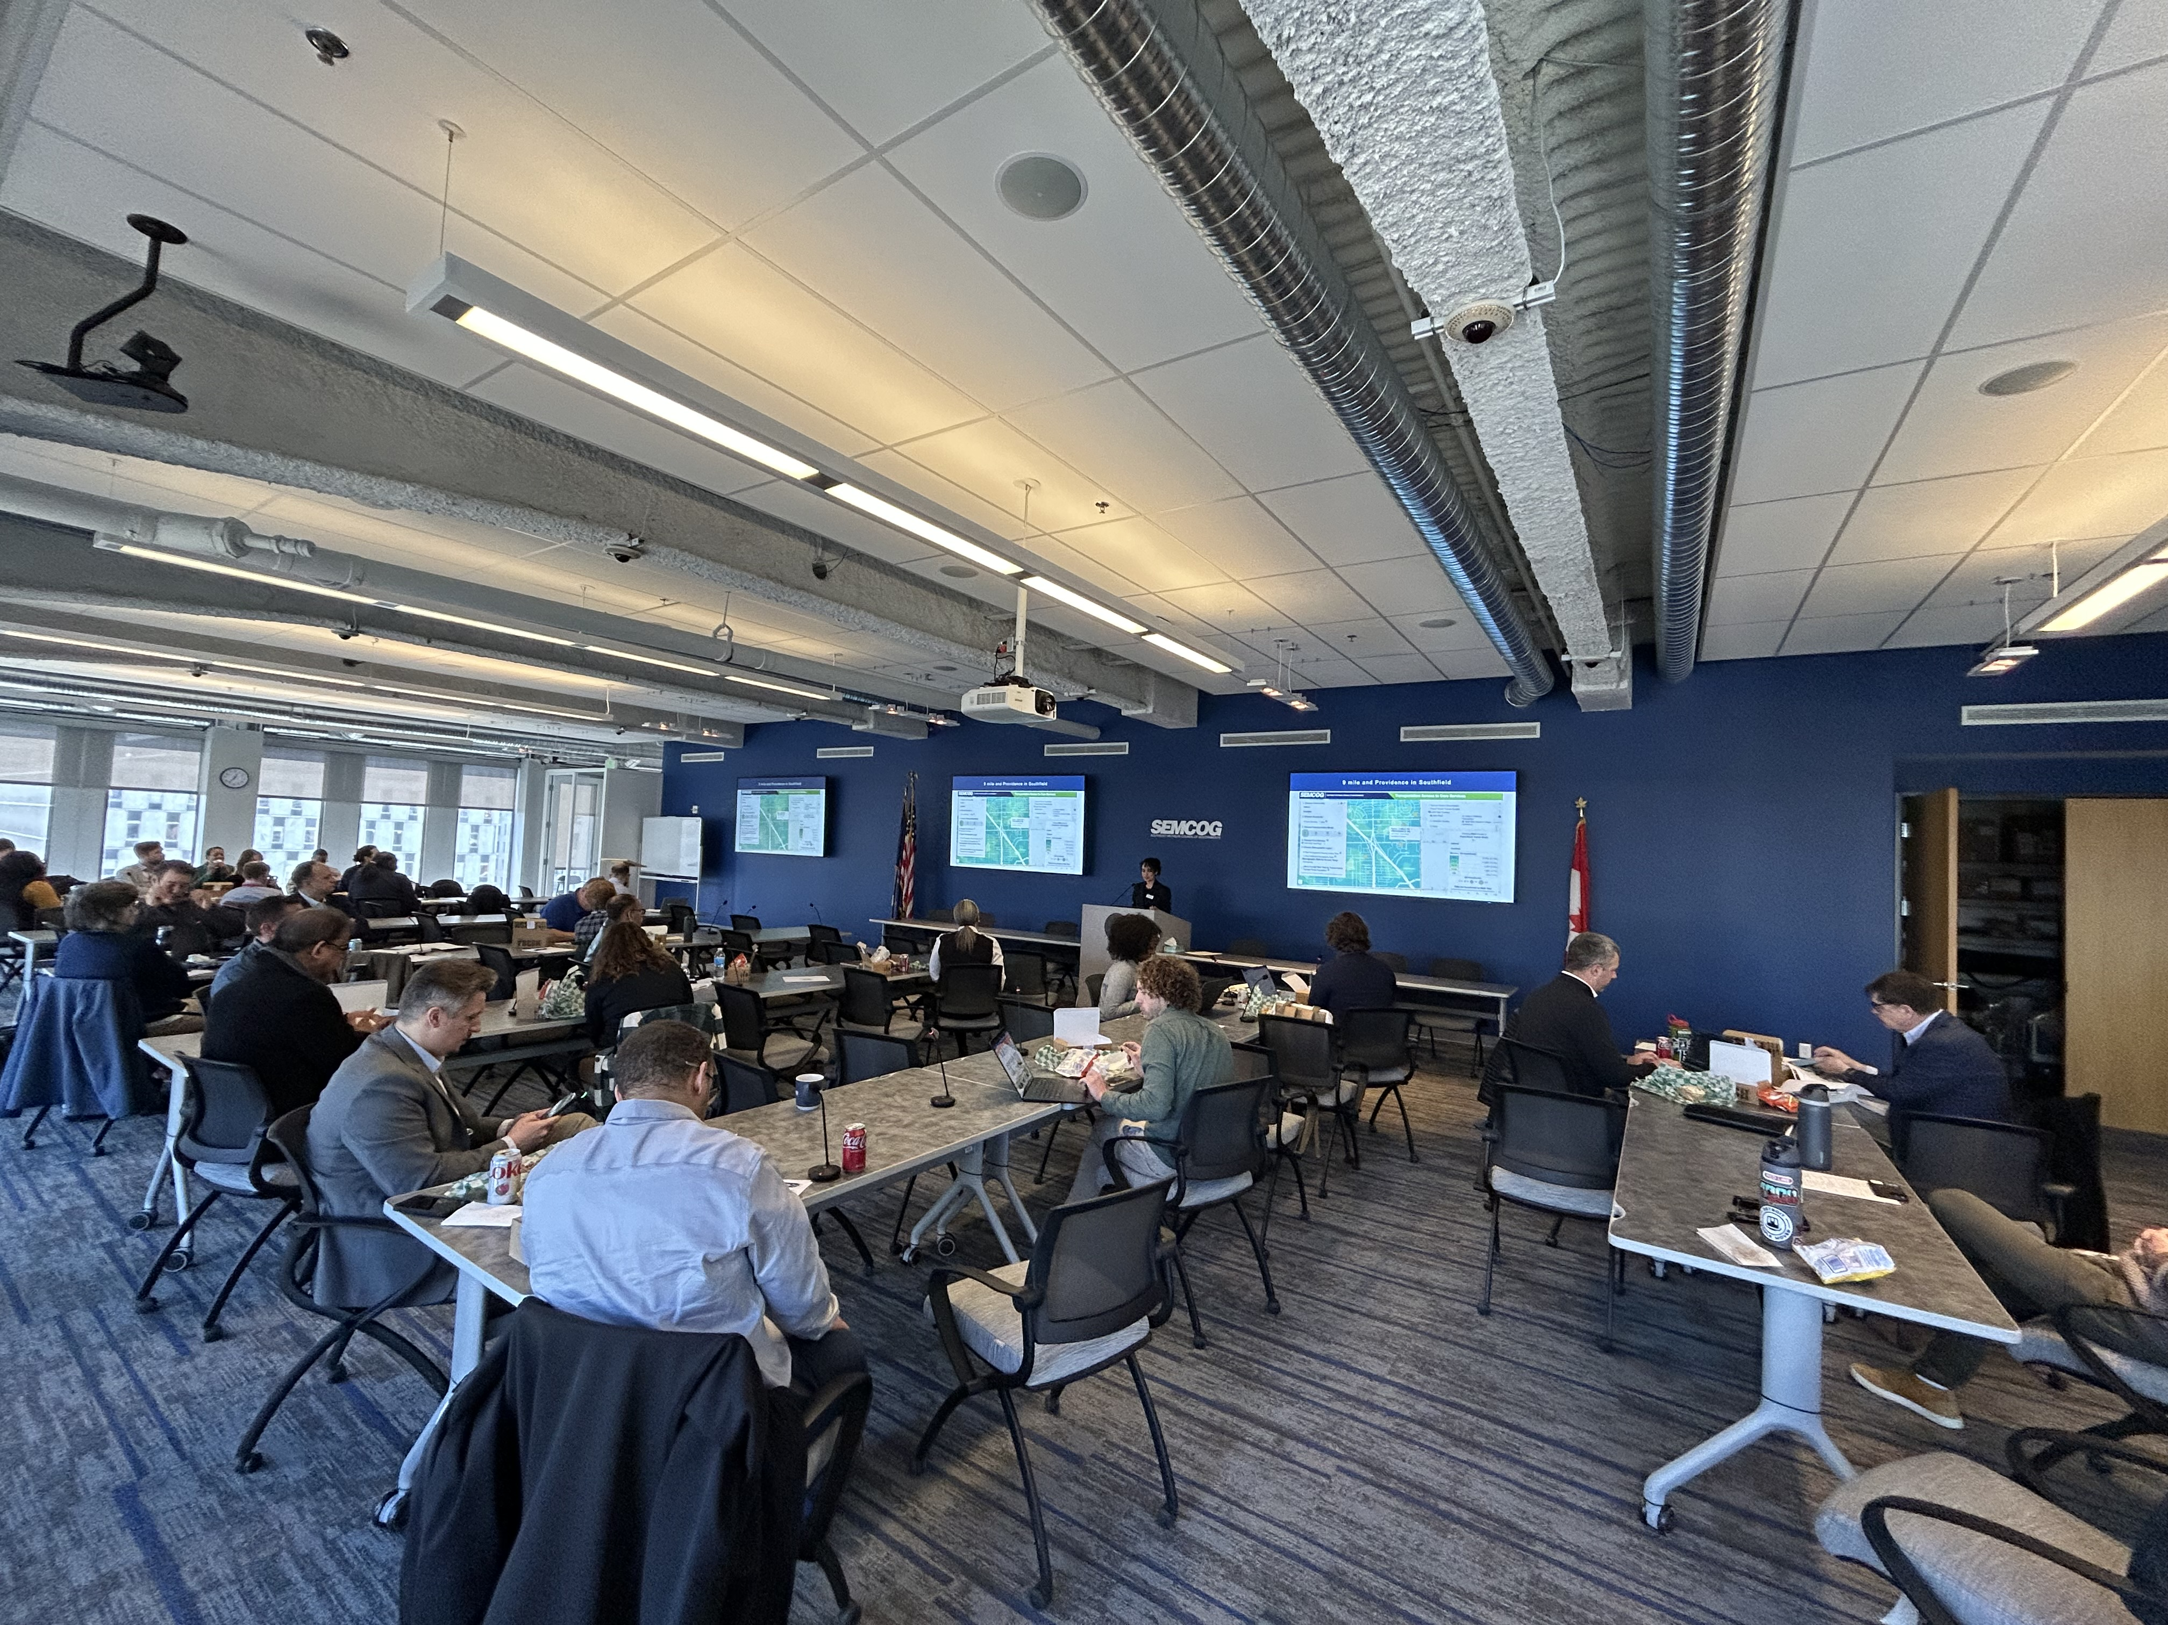
Access to Transit (ATP)
Five locations funded
  Macomb County – Warren
  Oakland County - Southfield
  Wayne County – Dearborn
  Wayne County – Detroit
  Washtenaw County – Pittsfield Twp.
April 8th kick-off
  Representatives from each community and provider agency were present.
NEPA / Section 106
  Received categorical exclusion and 'no adverse effect'

Slide 6
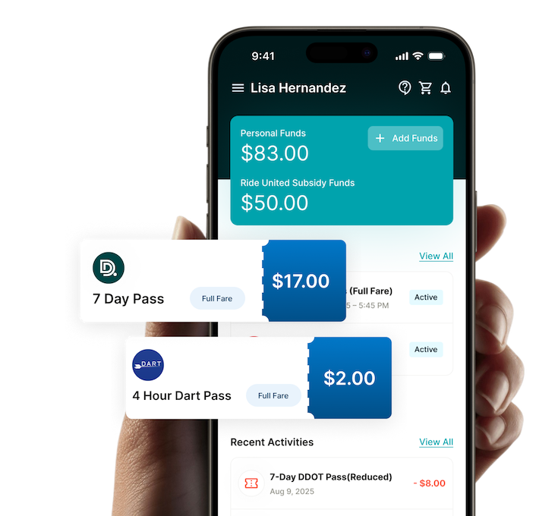
Mobility Wallet Pilot
"You guys made a sweet app. It's like there's no issues […] it's pretty straight forward. “ – User Acceptance Testing (UAT) feedback
~$1M Service Initiatives MDOT grant through the Michigan Mobility Challenge.
Built the MyRide Wallet app and web-based portal.
Partnered with United Way to test subsidy component.
Recruit up to 50 participants.
16 assessments.
Pilot to conclude May 31st with final report and executive summary by June 30th.
Grant concludes July 2nd.
"10 out of 10 would recommend open it up to the public. “- UAT feedback
“[…] everything is pretty much going good every driver that I've ran across have been able to look up quickly and except the past without any issues” – Pilot Participant Feedback

Slide 7
Mobility for All - Mobility Management
RTA’s Quarterly Mobility Management Coordination Committee includes:
  AgeWays
  PEAC
  Freedom Road Transportation Authority (FRTA)
  Richmond Lenox EMS (RLEMS)
  Western-Oakland Transportation Authority (WOTA)
  Our new regional smaller community providers operations committee kicked-off this week!

Slide 8
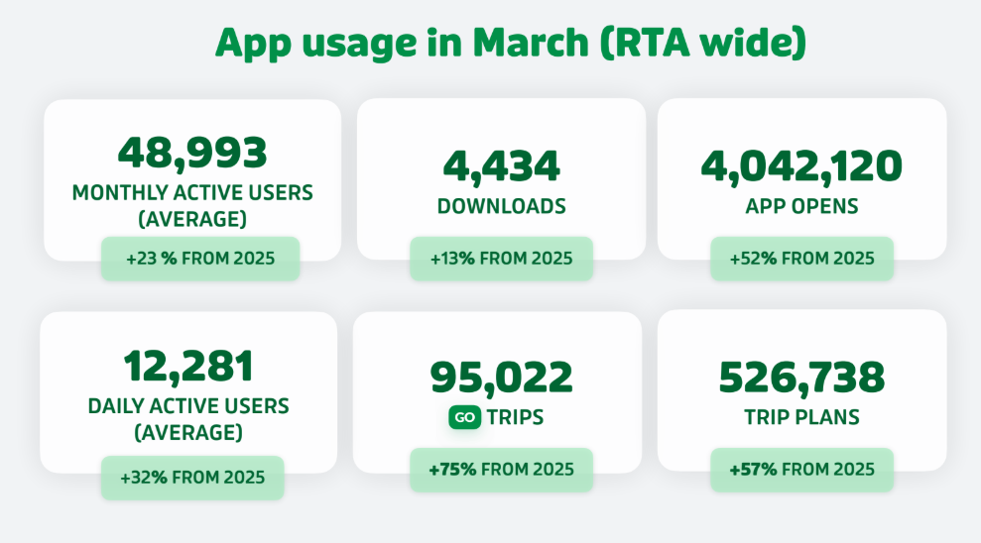
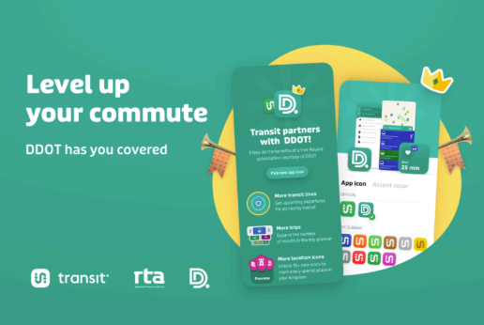
Transit app
MDOT Grant for 3-year pilot (July 2028)
Roll out of new features throughout pilot:
  New feature - Commute hours
  Coming soon - DAX/D2A2 fare payment integration
  Quarterly Office Hours to support Providers

Slide 9
New Projects

Slide 10
Woodward Corridor Modernization
Project concept
  MDOT M-1 Corridor Plan has a strong transit focus
  Federal Transit Administration (FTA) has a large capital funding program that can fund large scale corridor projects with a transit focus (Capital Investment Grant Program or CIG)
  RTA will lead a coordinated effort to scope a CIG project to compete for funding in that program
  Does not preclude work on critical short-term projects!

Slide 11
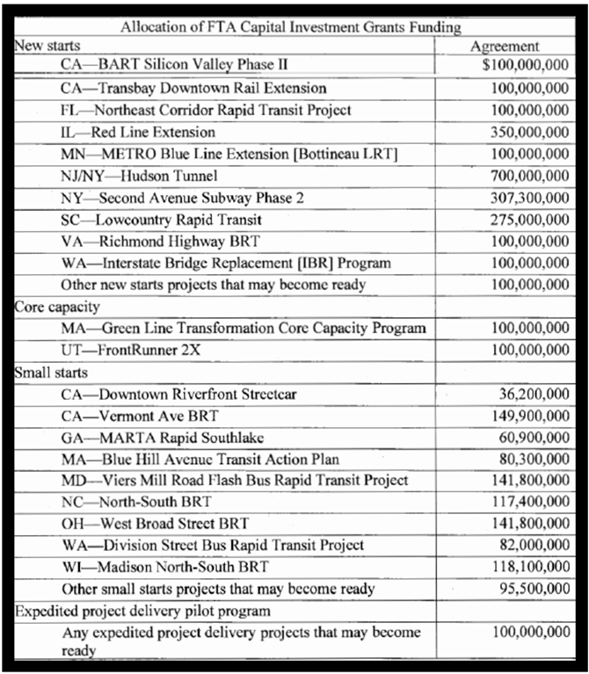
Woodward Corridor Modernization
Current CIG Projects
Why the FTA CIG Program?
  1.Scale – only federal program that provide funding for large corridor projects
  2.Alignment – transit is already a community priority and that is the focus of this program; funds transit-supportive elements too
  3.Competitiveness – Woodward has all the key elements to be a winning project

Slide 12
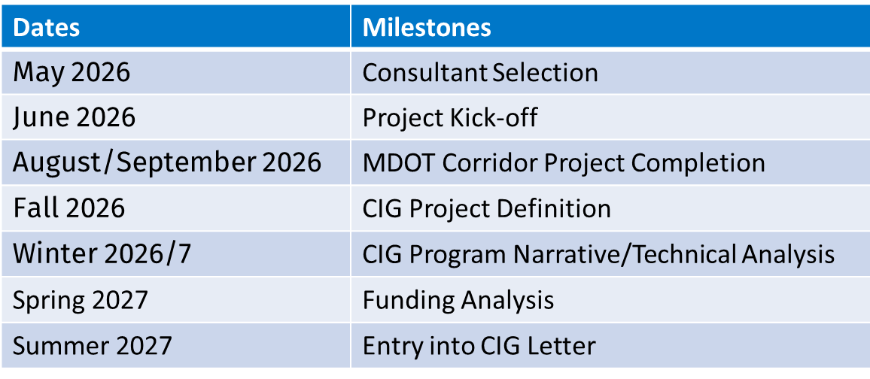
Woodward Corridor Modernization
Project status
Partners will be critical stakeholders in this process!
Next Steps
Bring on consultant to support the process
Schedule a summer kick-off meeting
Present status quarterly at RTA Board meetings

Slide 13
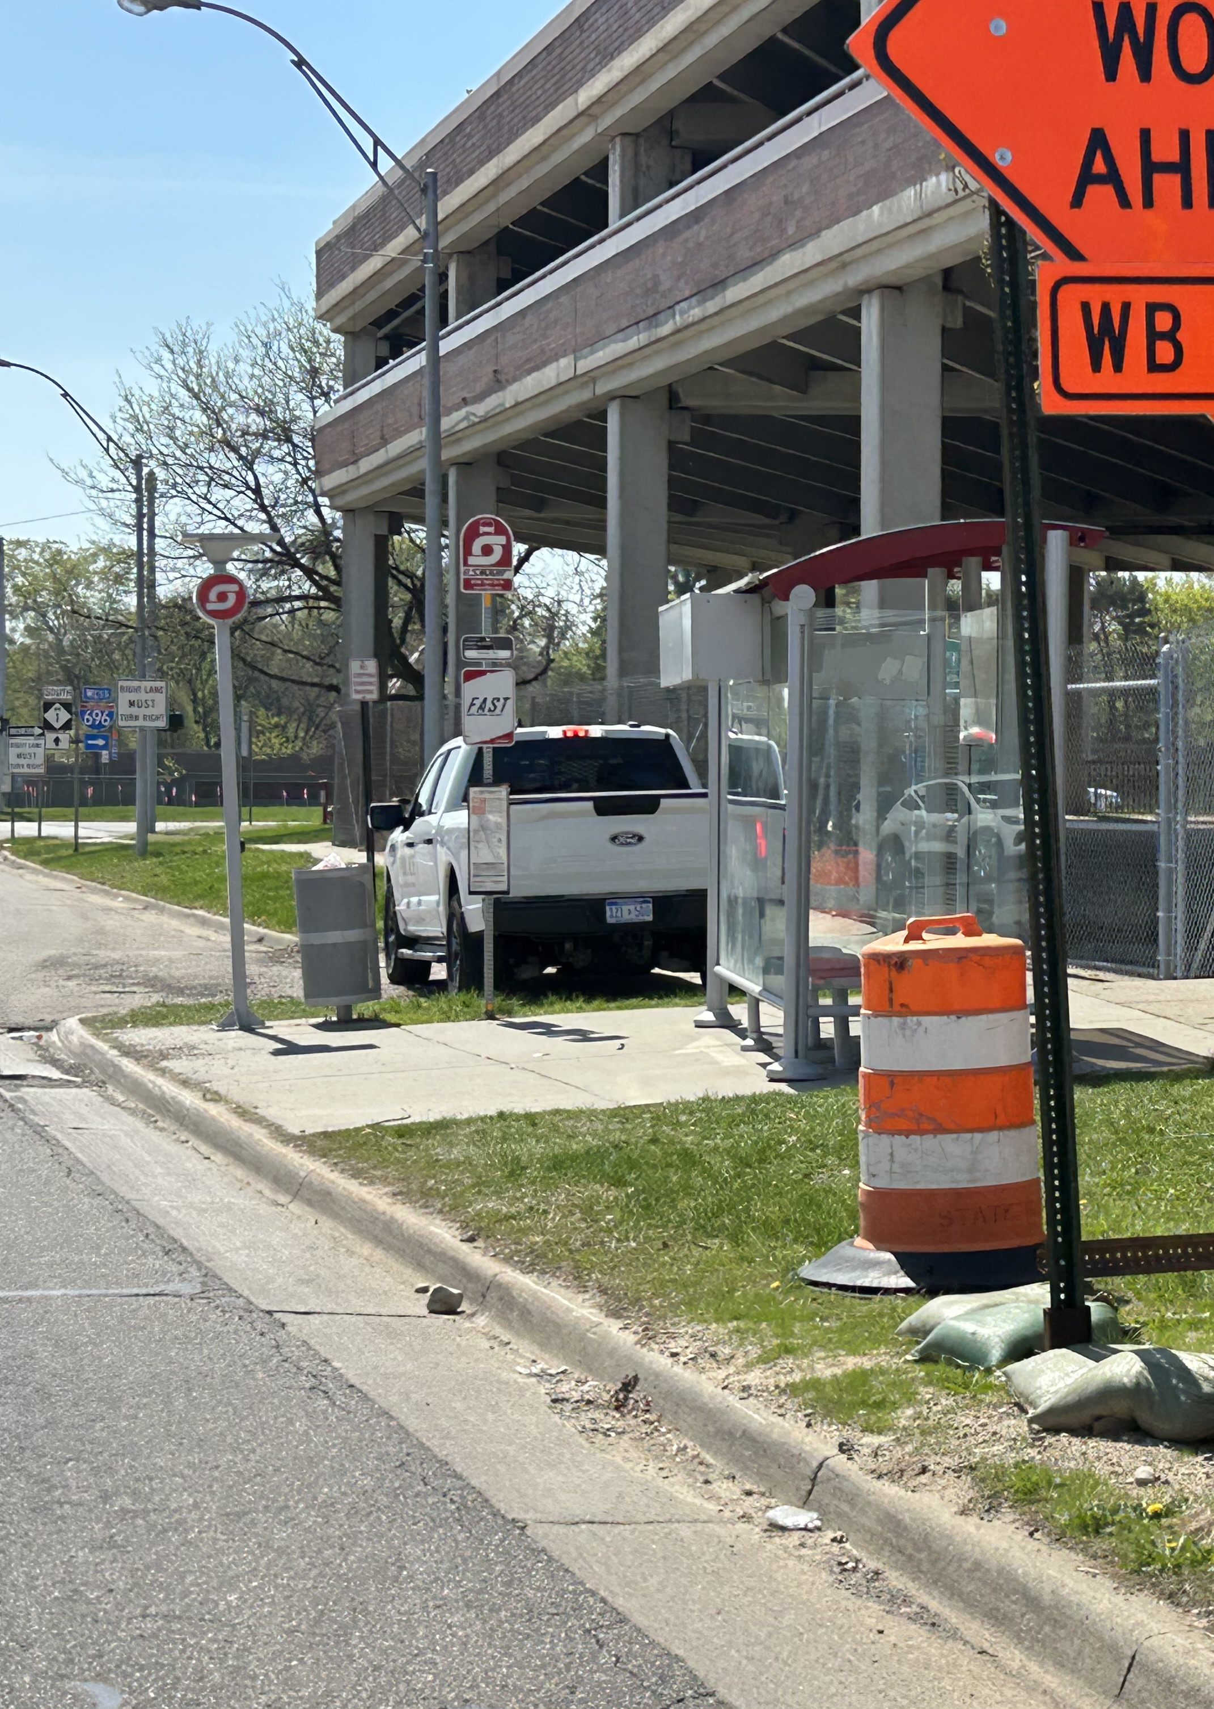
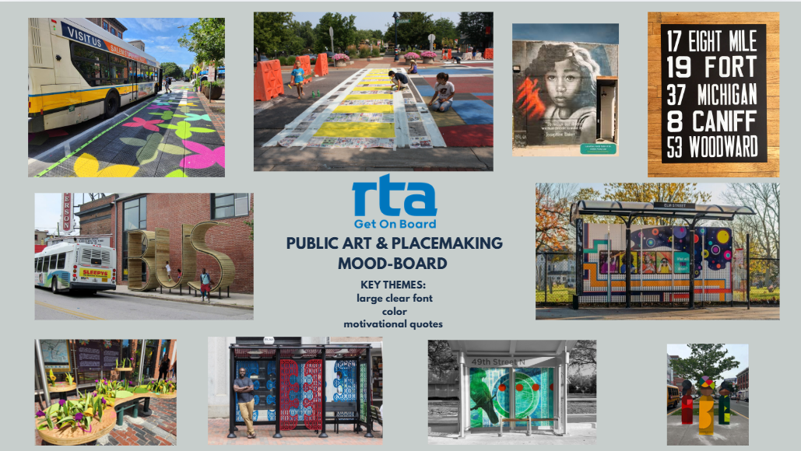
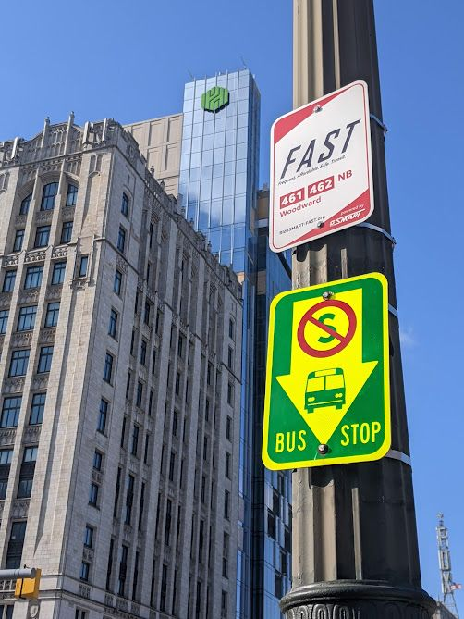
TCP Subaward
Placemaking & Public Art Project
RTA & Library Street Collective are developing 2 temporary quick build and public art installations that integrate creative expression with transportation infrastructure to improve safety, wayfinding, and sense of place at key regional transit corridor intersections and mobility hubs.

Slide 14
Grants and NTD

Slide 15
Grant Awards Snapshot
Federal Grants | Amount | Est. Completion | Note
Mobility For All (5310) | $1 M | September 2027 | Amendment in review by FTA for FY funds – part of a bigger program
QLINE Preventative Maintenance (5307/5337) | $1.4 M | September 2027 | Amendment in review by FTA for FY funds
Access to Transit Program (ATP) Construction (CMAQ) | $5 M | September 2028 | New FTA obligation request next
Congressionally Directed Spending | $2.6 M | September 2028 | Awaiting official FTA announcement
MDOT Grants | Amount | Est. Completion | Note
Access to Transit Program (ATP) Planning (Service Initiatives) | $1.4 M | September 2026 | In progress for FY26 funds
Mobility Wallet Pilot (Service Initiatives) | $1 M | July 2026 | Scheduled to wrap up in June
TRANSIT app (Service Initiatives) | $800 k | July 2028 | Planned to include integration for DAX and D2A2 ticketing
QLINE Preventive Maintenance (5307/5337 state match) | $300 k | September 2027 | Awarded once the federal amendment is approved by FTA

Slide 16
National Transit Database (NTD)
RTA's FY 2025 NTD Annual Report was submitted to FTA, complete with no outstanding revisions needed.
This was RTA's first year reporting for D2A2, DAX, and QLINE since adoption in October 2024.
QLINE Automated Passenger Counter (APC) surveys are due in FY 2026 for assessment of new ETA system alignment with NTD standards and then in FY 2028 followed by every 3 years after.

Slide 17
And More!

Slide 18
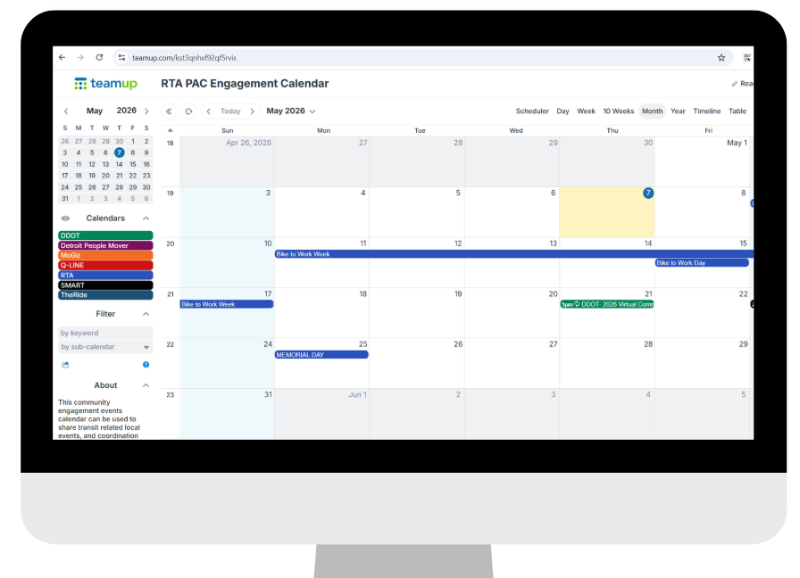
Community Engagement Calendar
RTA launched the Provider Advisory Committee (PAC) Engagement Calendar to share transit related local events and coordination opportunities within Southeast Michigan.
We have received positive feedback from the PAC for this initiative, and the calendar is updated with events monthly.

Slide 19
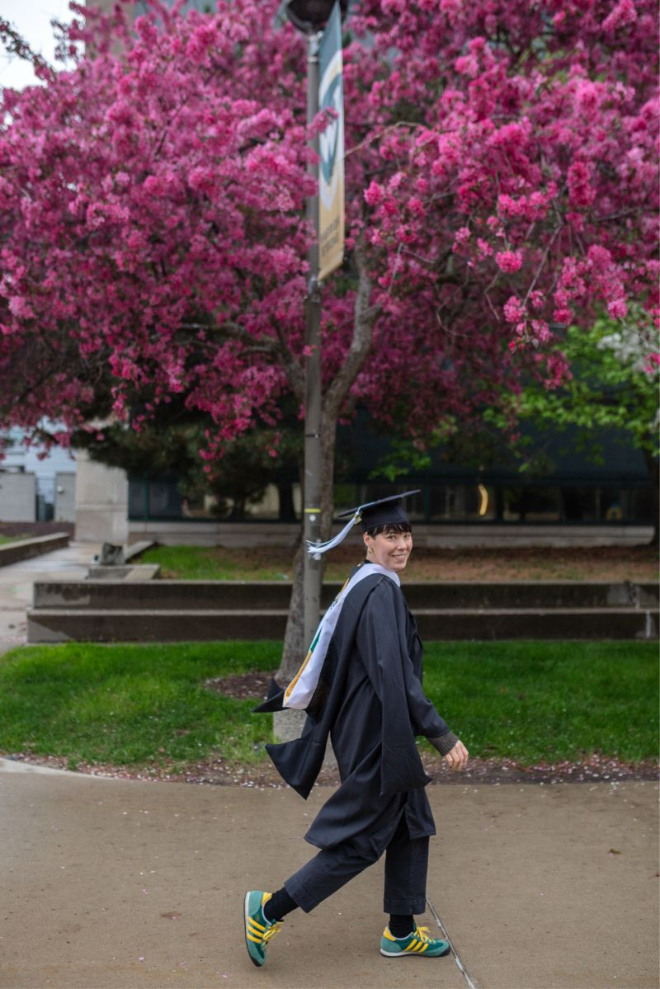
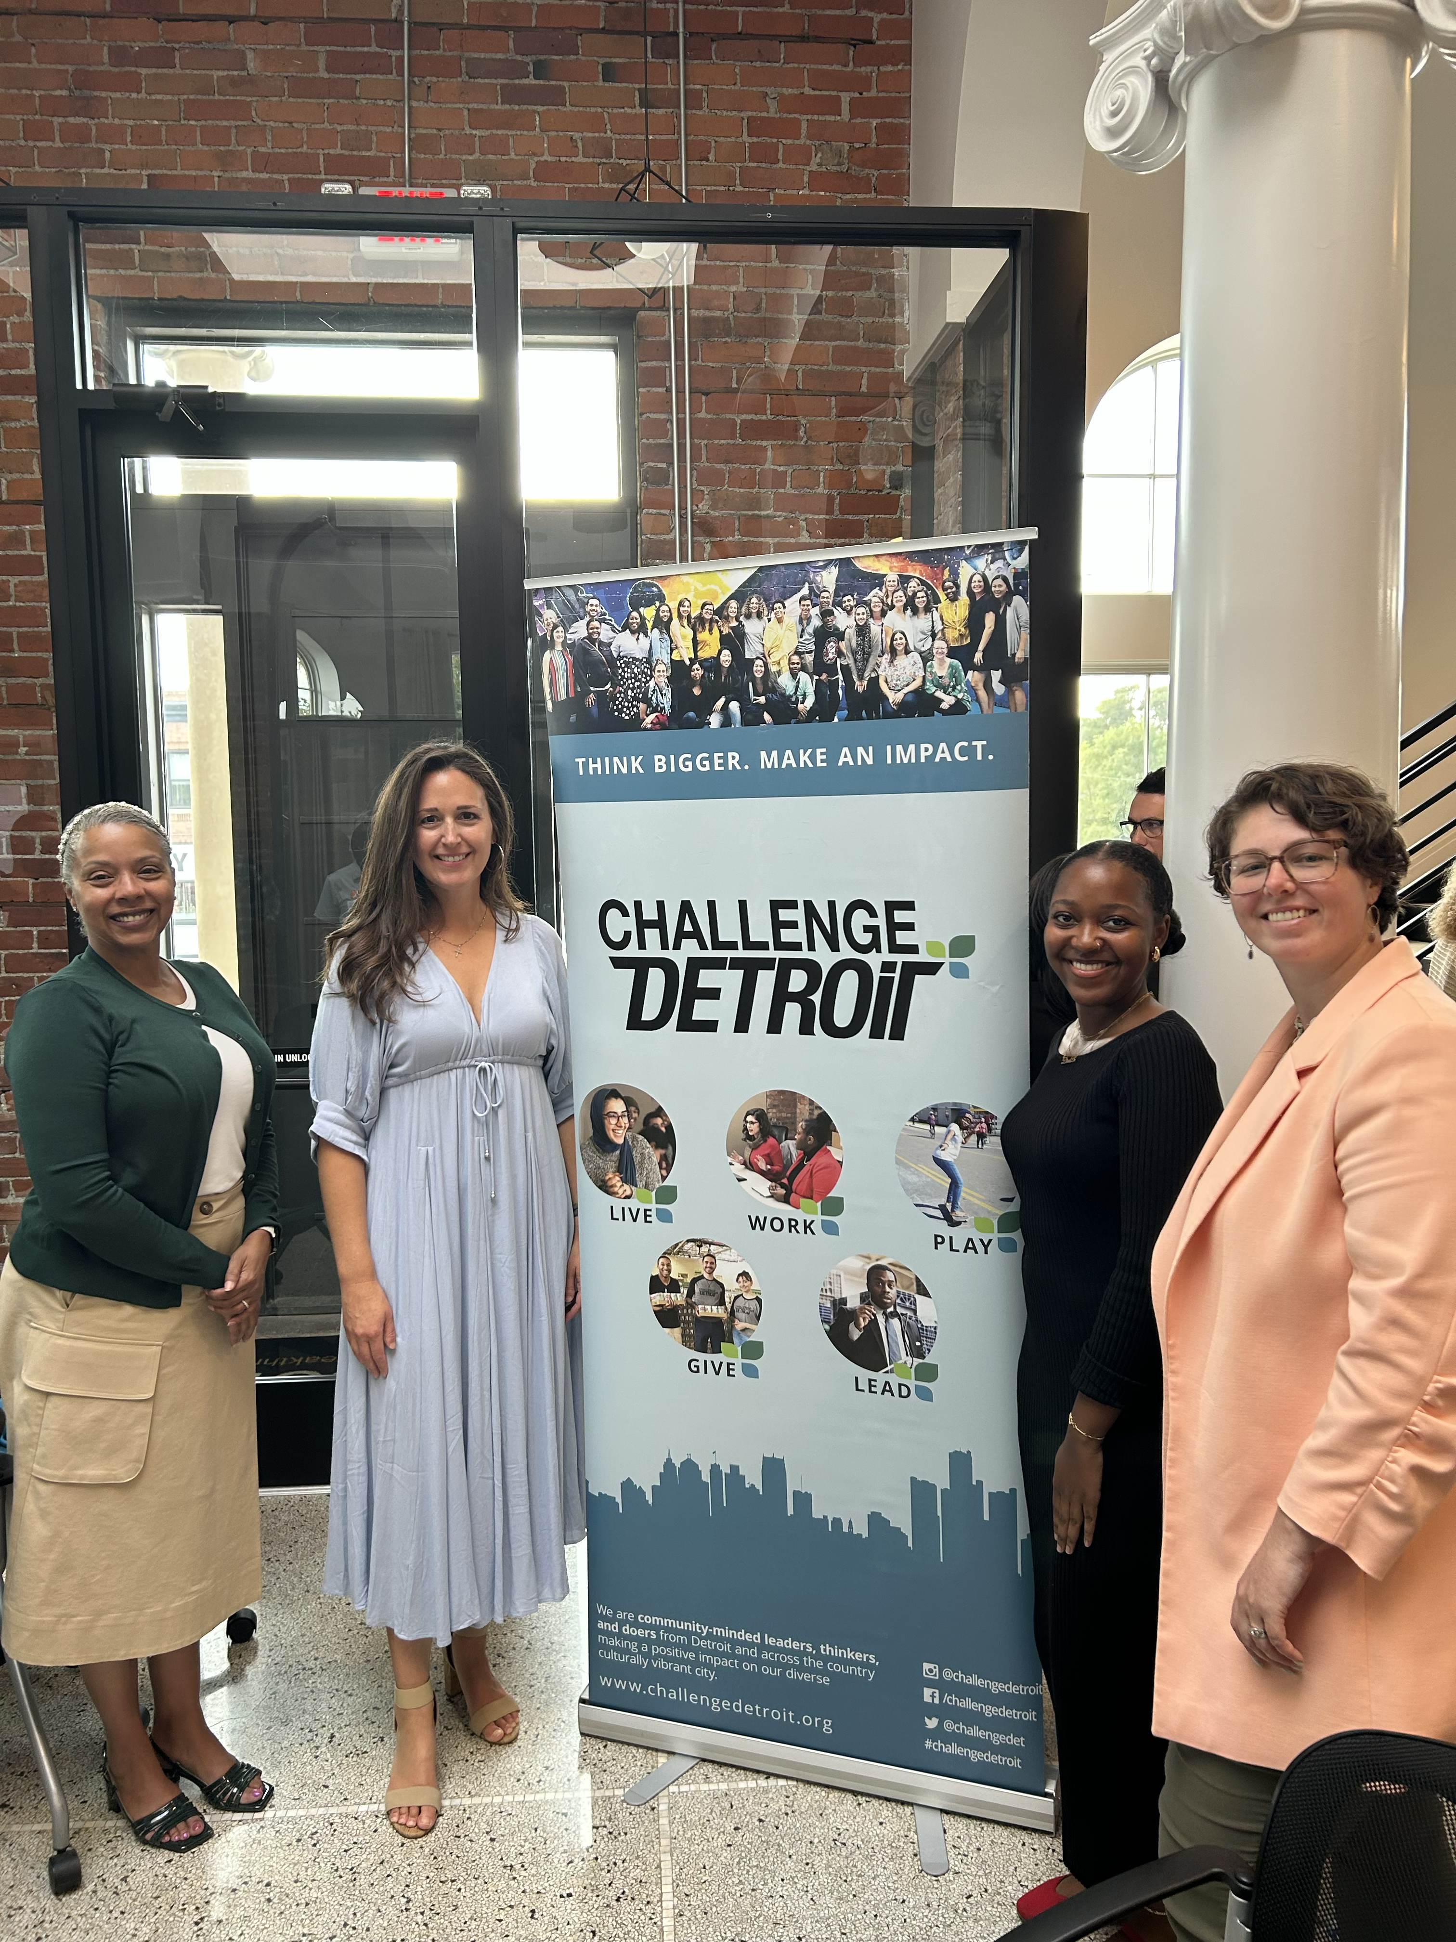
Congrats KC on becoming a master planner and Drue as a Challenge Detroit alumna!
Kristin Caffray (KC) our Senior Planning Strategist graduated on May 7th from Wayne State University with a Masters in Urban Planning!
Drue Bender our Transit Innovation Fellow successfully completed the Challenge Detroit program on May 15th, a member of its final cohort.
Congratulations!!

