Slide 1
Executive Director’s Report
May 21, 2026

Slide 2
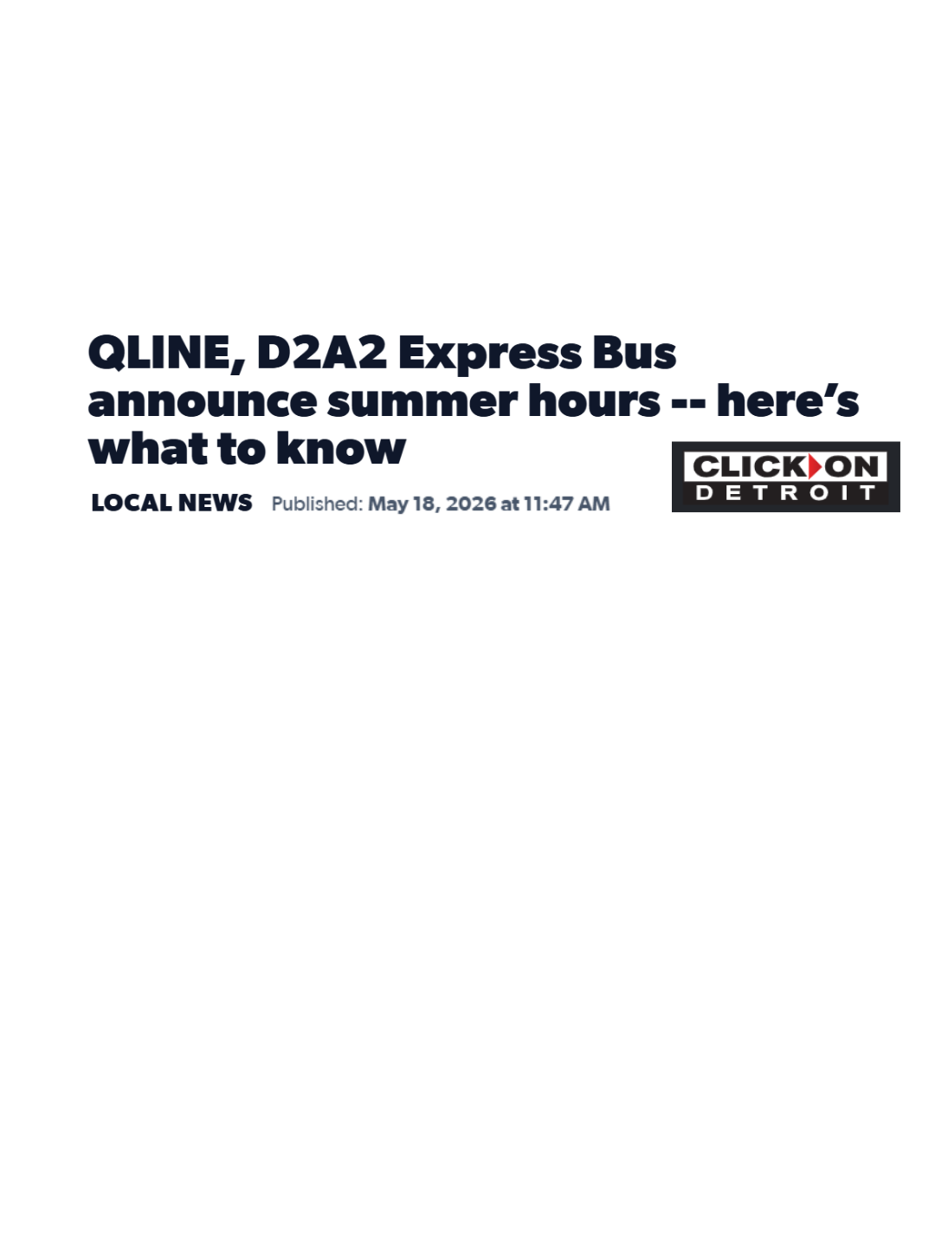
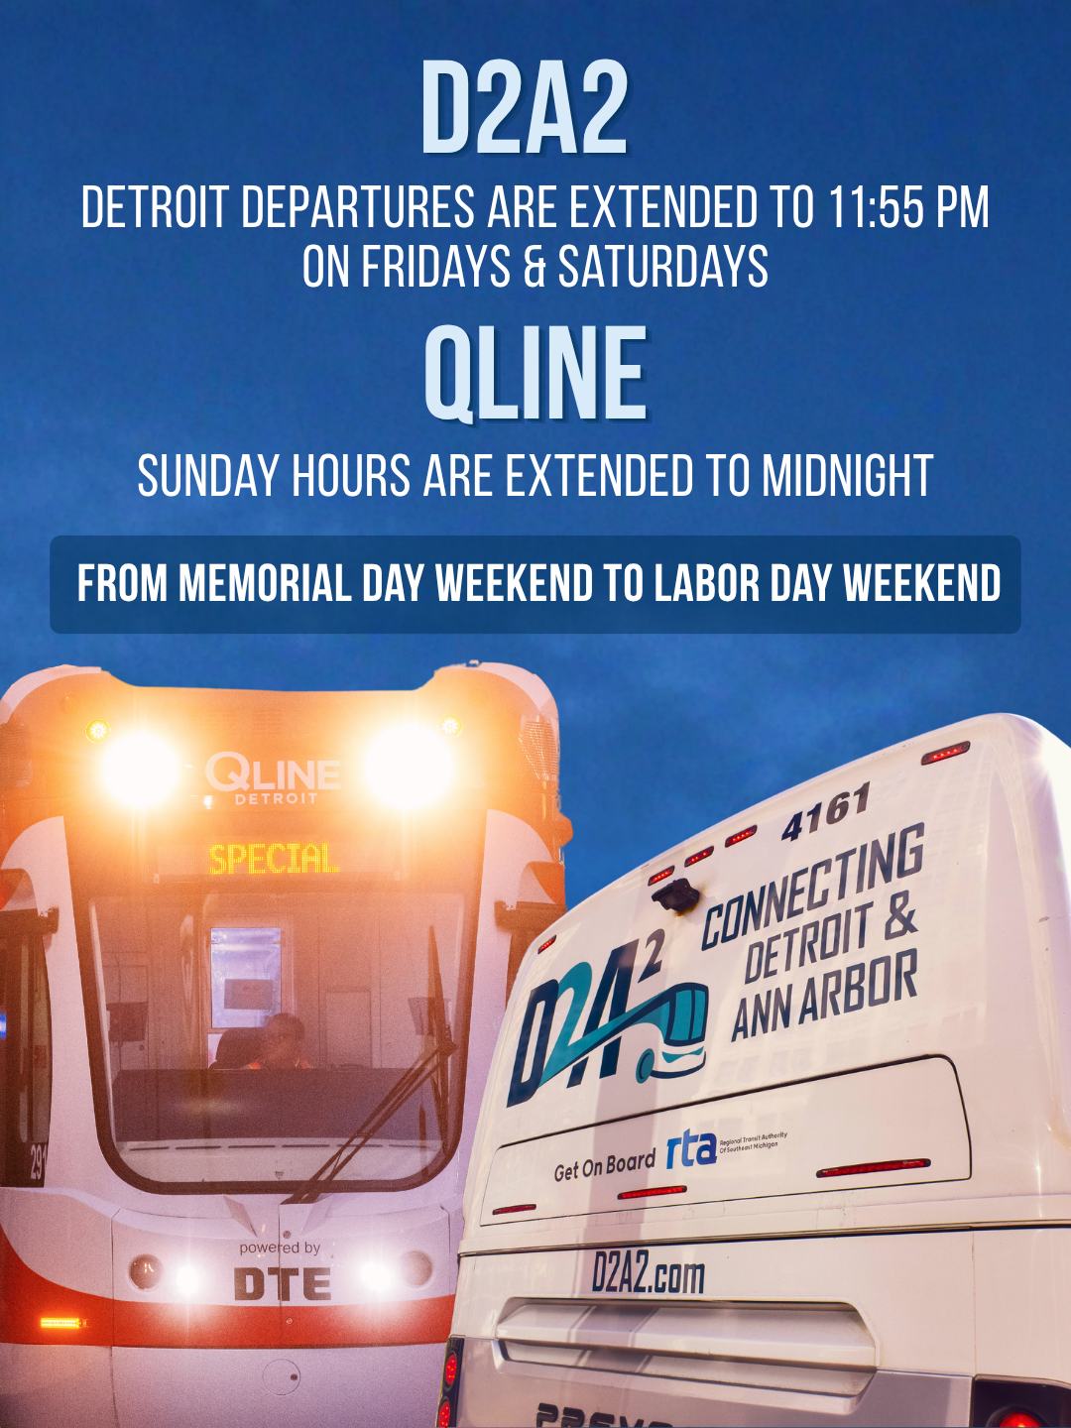
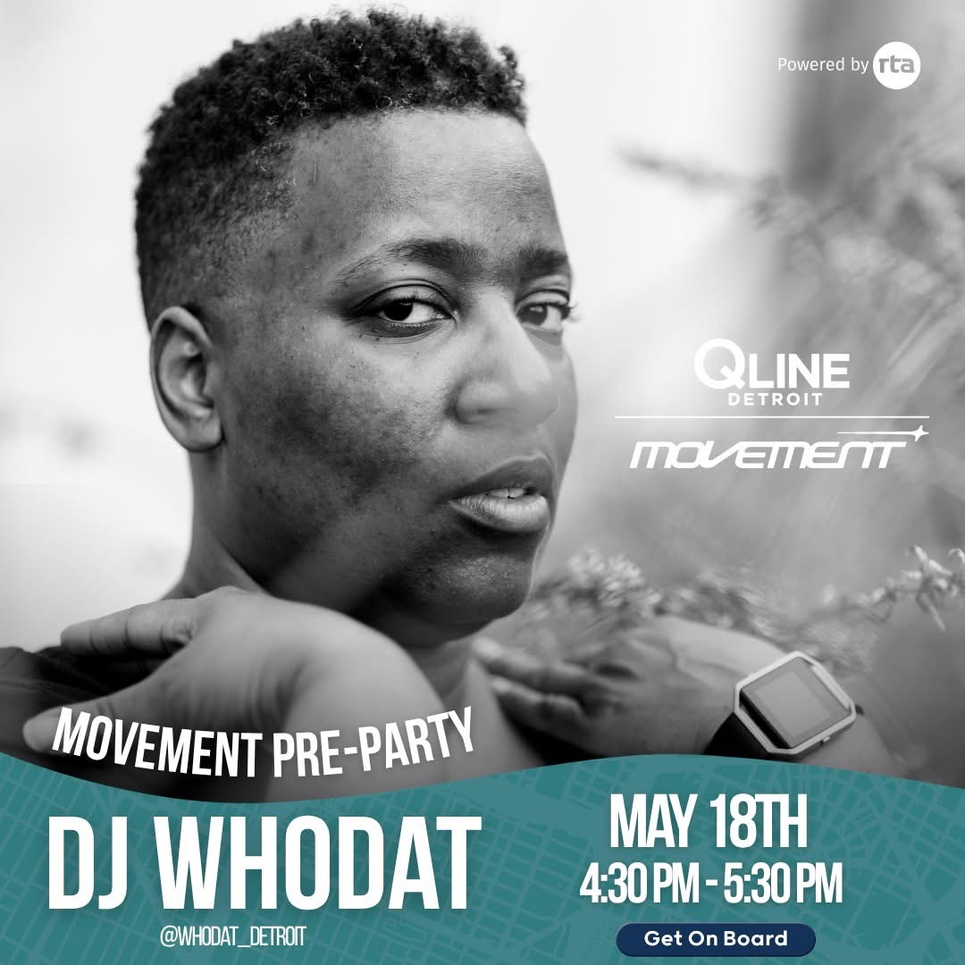
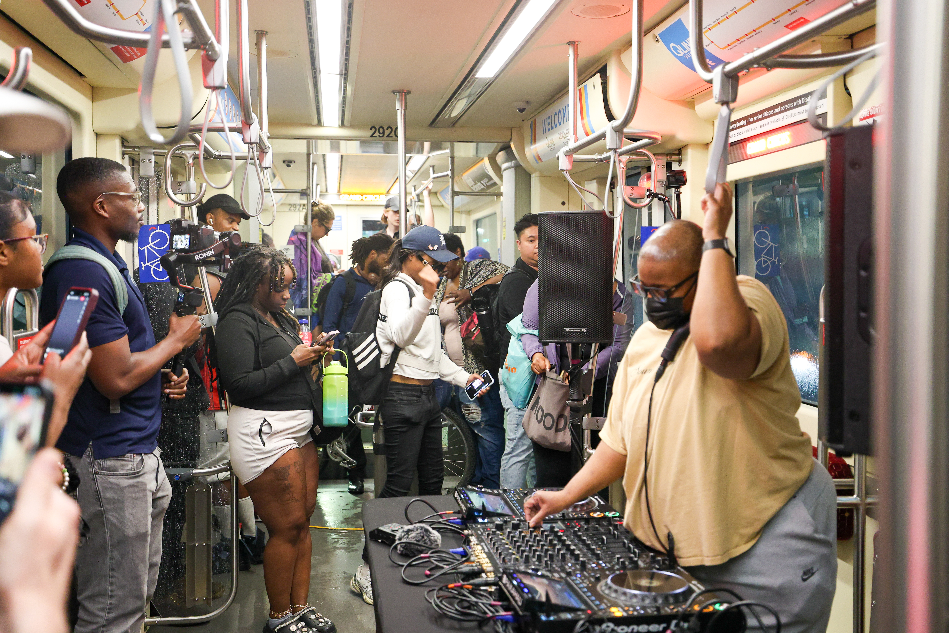
BIG NEWS: Transit Summer Season Kicks Off Tomorrow

Slide 3
QLINE RIDERSHIP
2026 Goal | 1,159,198
YTD Target | 337,177
YTD Actual | 338,760
On/Off Target | +0.5%

Slide 4
QLINE PERFORMANCE
Metric | Target | Q1 | April
Completed Trips | Over 90% | 80% | 85%
On-time at Grand | Above 90% | 84% | 93%
On-time at Congress | Above 85% | 79% | 85%
On-time on alignment | Above 70% | 69% | 80%
Challenges:
Signal aspects and switches need improved maintenance
Vehicle availability due to ongoing maintenance needs
Solutions:
Signal and switch maintenance contracts are up for renewal
Evolving switch maintenance procedures
Proactive capital planning for vehicles

Slide 5
D2A2 and DAX RIDERSHIP
2026 Goal | 15% increase
D2A2 | 18%
DAX | 12%

Slide 6
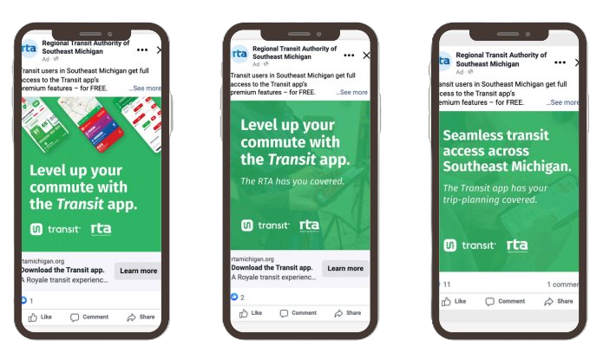
TRANSIT APP
Key Performance Indicators
Initial Focus - Downloads and Users (Goal: 20% increase year over year)
Other Indicators – Sessions, System Usage (trips/ratings), Mobile Payment Usage
Metrics (April 2026)
Users: 50,710 (+24% from April 2025)
Downloads: 4,893 (+32% from April 2025)
Sessions: 4.34M (+52% from Apirl 2025)
Marketing
Social Media ads in Feb – April
  1.12 million impressions
  5,285 clicks (1.24% click through rate)
Mackinac Policy Conference LinkedIn Advertising
Notes:
Downloads were a negative percentage for January, in part due to the bitter cold and ice all ridership was down. Transit notes ridership across the board is usually less in January

Slide 7
PROGRAM UPDATES
New State Infrastructure Funding: Call for Projects Released; Applications due on June 30th
Procurements in Process: IT Managed Services, Custodial Services, Woodward Pre-CIG Task Order
Woodward Modernization Project: Strategic Workshop on 5/22
Attending Mackinac Policy Conference next week

Slide 8


BIKE SAFETY CAMPAIGN
Public Safety Announcement Video
Safety tips for riding around the QLINE streetcar and tracks
  Shared during National Bike Safety Month
Shared on the QLINE website, RTA YouTube channel, and social media
Performance: 959 views across YouTube & social media
Website Updates
New Bike Safety section on the QLINE website
  On the NEW Rules of the Rail web page.
New iconography from our marketing partners FWV.
New Physical Signage – Being Installed

Slide 9

BIKE SAFETY CAMPAIGN

Slide 10
UPCOMING ITEMS
FY2027 Budget Development and Approval
Board Officer Slate
QLINE Capital Plan
IT Managed Services Contract
Custodial Services Contract
QLINE On-Call Maintenance Contract(s)
Public Transit Agency Safety Plan
Mobility Wallet Pilot Completion and Next Steps
Access to Transit MOUs

Slide 11

FARWELL ISAAC CONSTANS

