Slide 1
Executive Director’s Report
March 19, 2026

Slide 2
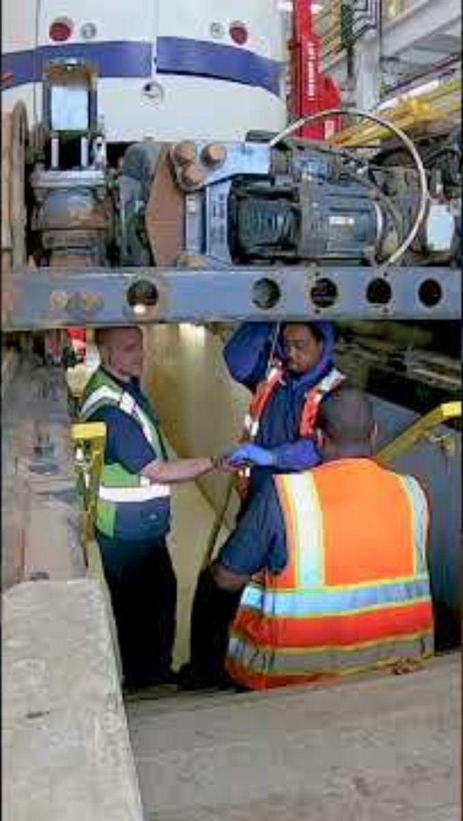

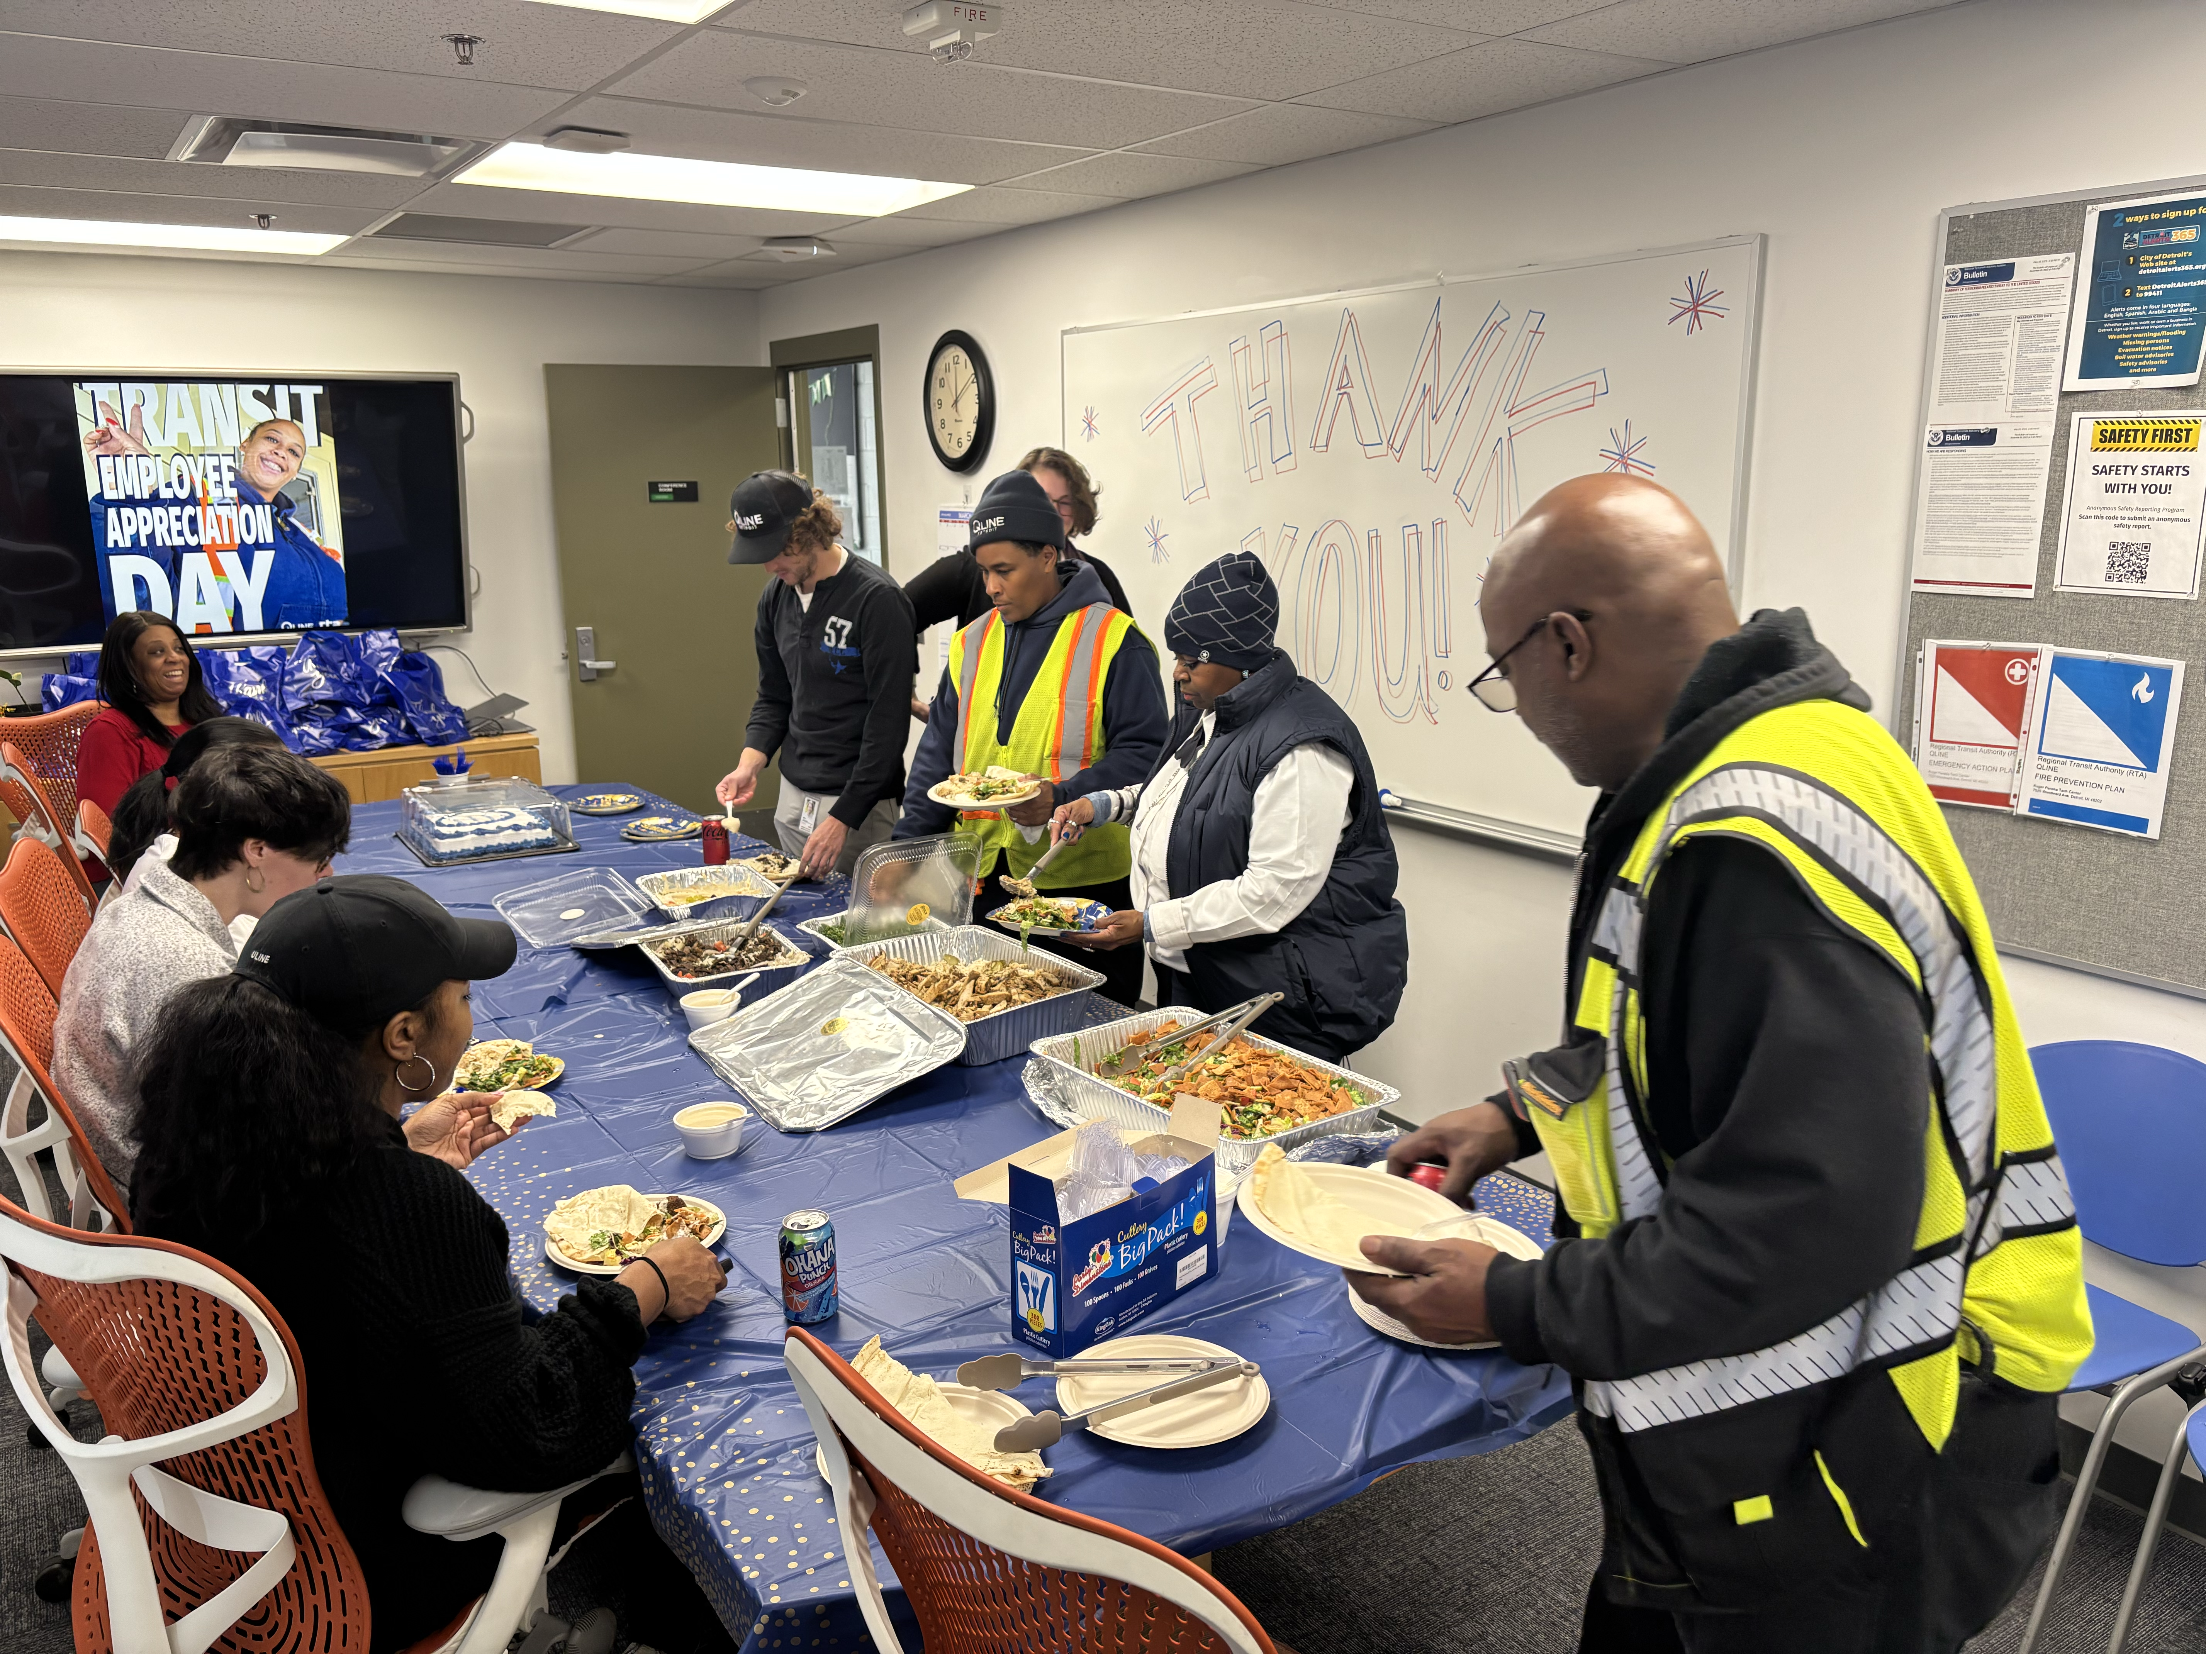
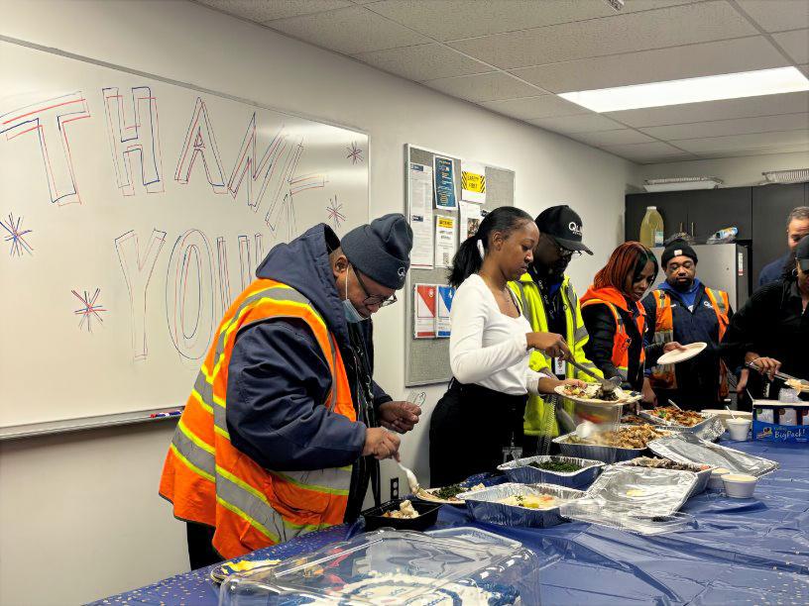
BIG NEWS
Transit Employee Appreciation Day – March 18

Slide 3
QLINE RIDERSHIP
2026 Goal | 1,159,198
YTD Target | 137,280
YTD Actual | 136,318
On/Off Target | -0.7%

Slide 4
QLINE PERFORMANCE
Metric | Target | Jan | Feb
Completed Trips | Over 90% | 80% | 86%
On-time at Grand | Above 90% | 80% | 87%
On-time at Congress | Above 85% | 71% | 80%
On-time on alignment | Above 70% | 61% | 67%
Challenges:
Signal aspects and switches need improved maintenance
Vehicle availability
Station monitors need to be updated
Solutions:
Signal and switch maintenance contracts are up for renewal
Evolving switch maintenance procedures
New station monitor equipment is being installed

Slide 5
D2A2 and DAX RIDERSHIP
2026 Goal | 15% increase
D2A2 | 22%
DAX | 23%

Slide 6
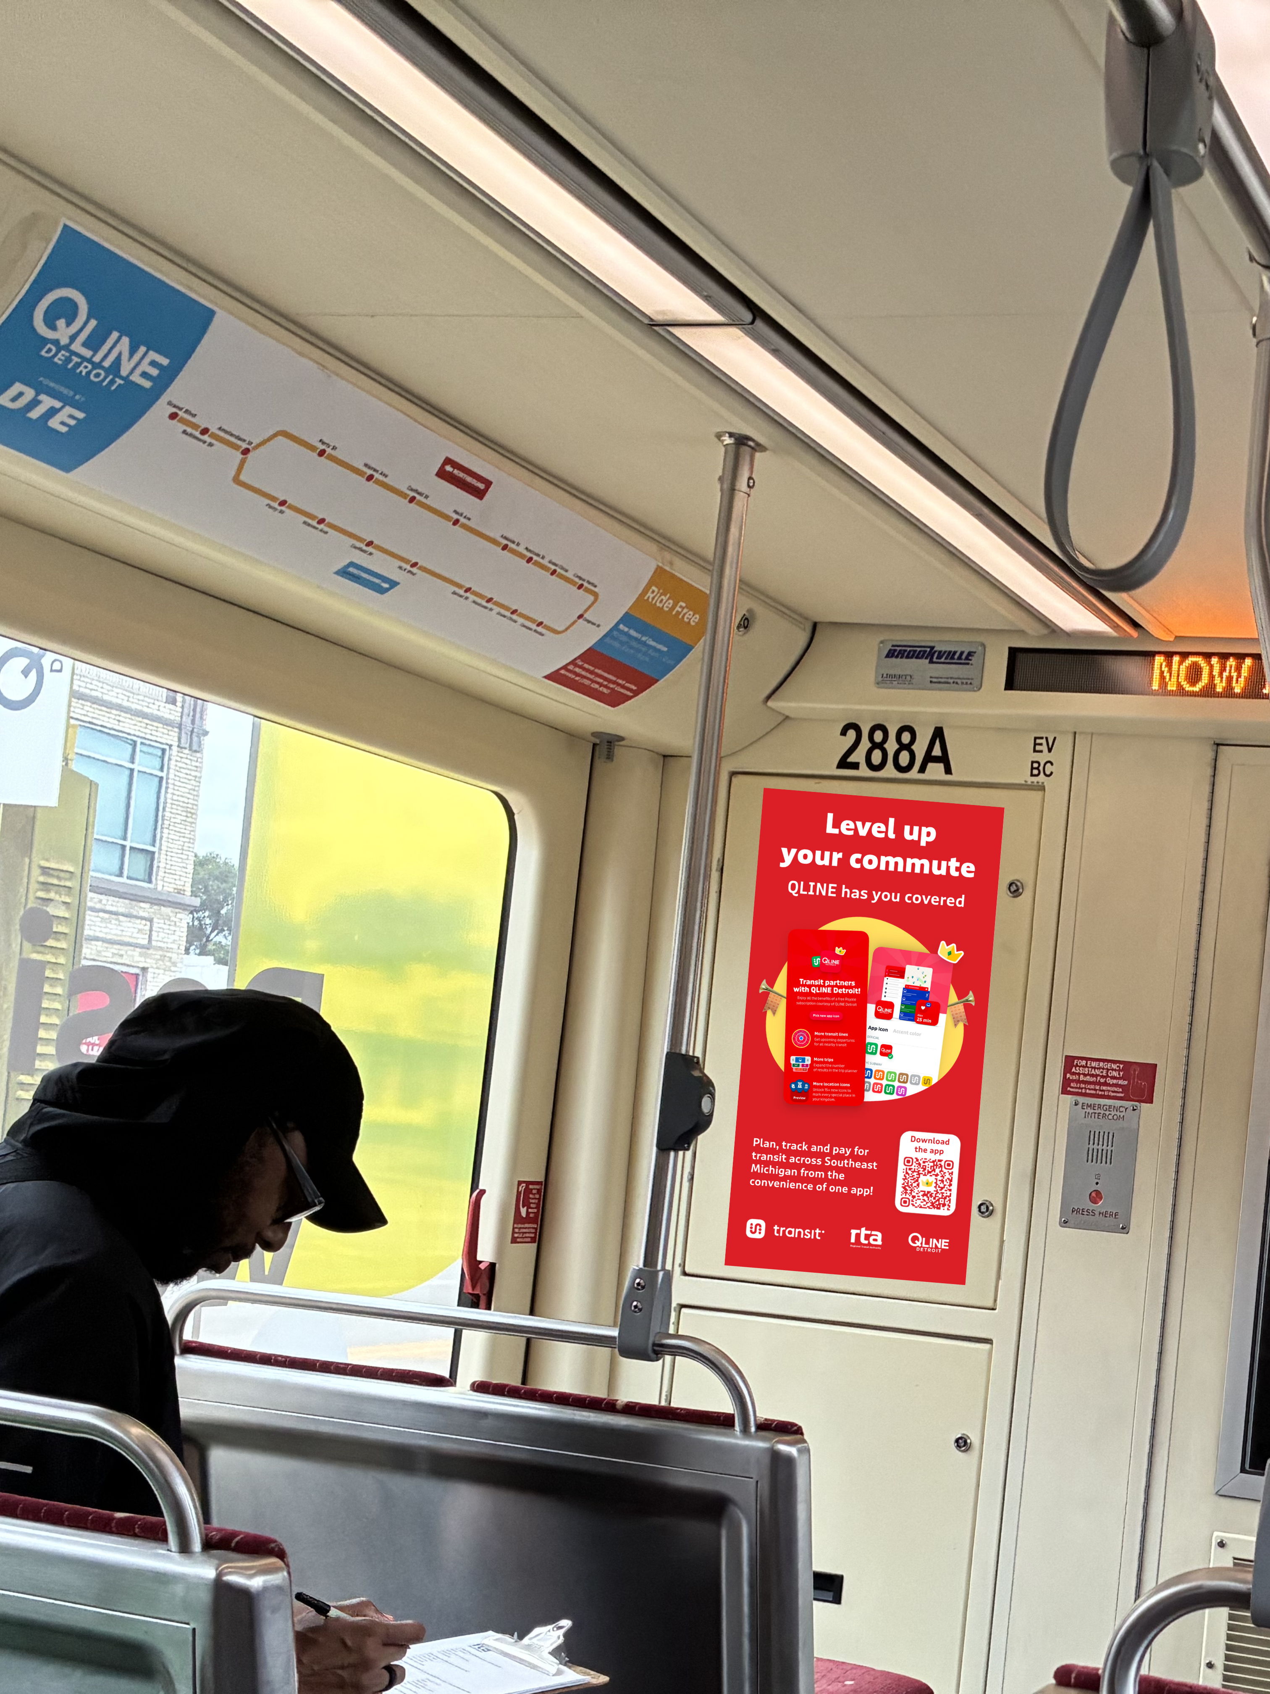
TRANSIT APP
Key Performance Indicators
Initial Focus - Downloads and Users (Goal: 20% increase year over year)
Other Indicators – Sessions, System Usage (trips/ratings), Mobile Payment Usage
Metrics (Feb 2026)
Users: 44,668 (+23% from Feb. 2025)
Downloads: 3,886 (+22% from Feb. 2025)
Sessions: 3M (+29% from Feb. 2025) - average of 68 sessions per rider
Marketing
Vehicle/Stops/Station Decals
Rider Education
Notes:
Downloads were a negative percentage for January, in part due to the bitter cold and ice all ridership was down. Transit notes ridership across the board is usually less in January

Slide 7

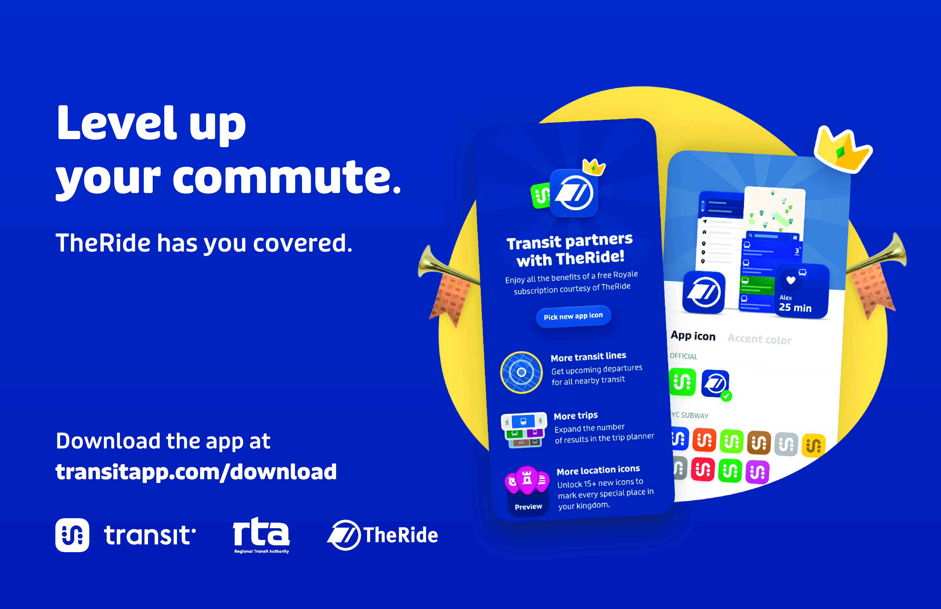
TRANSIT APP STATION & STOP DECALS
Notes:
Downloads were a negative percentage for January, in part due to the bitter cold and ice all ridership was down. Transit notes ridership across the board is usually less in January

Slide 8
PROGRAM UPDATES
Regional Capital Program and Federal Funding Action scheduled for April
Procurements in process: IT Managed Services, Fiber Network Managed Services, Enterprise Resource Planning Tool
New State Infrastructure Funding: Call for Projects in April
Finalist Access to Transit Sites Identified: Southfield, Detroit, Warren, Pittsfield Township, and Dearborn

Slide 9
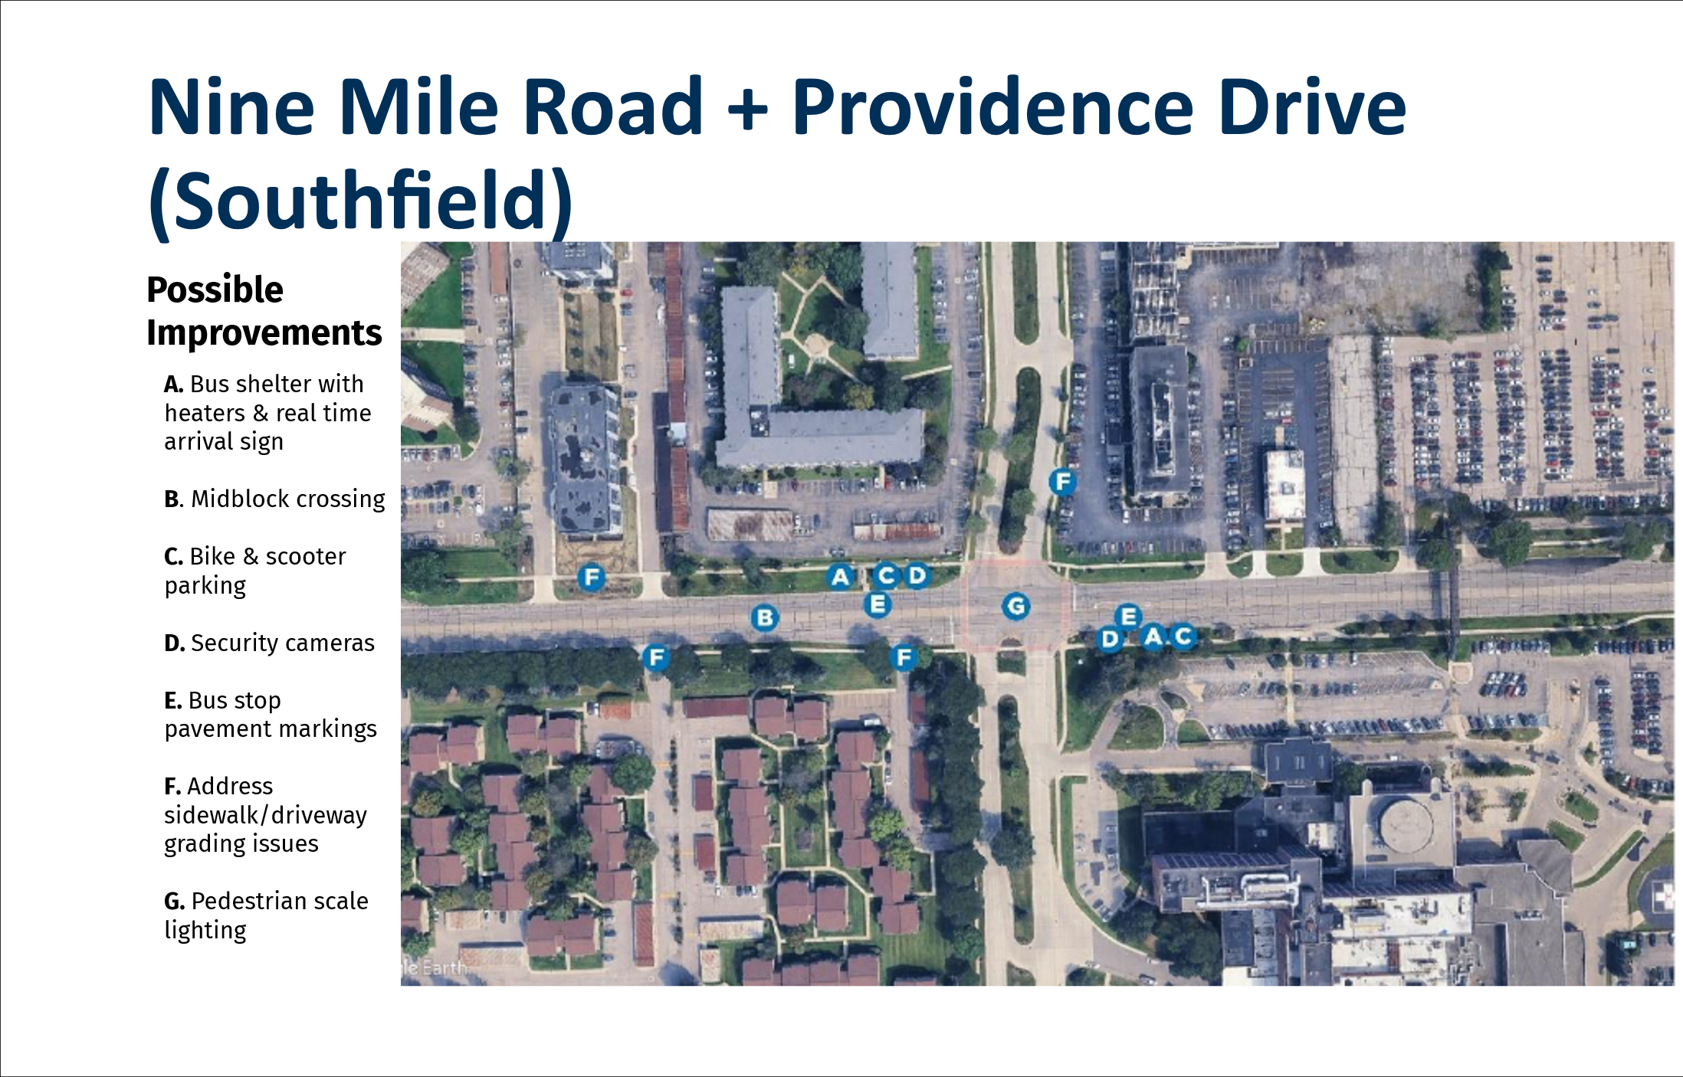
ATP EXAMPLE

Slide 10
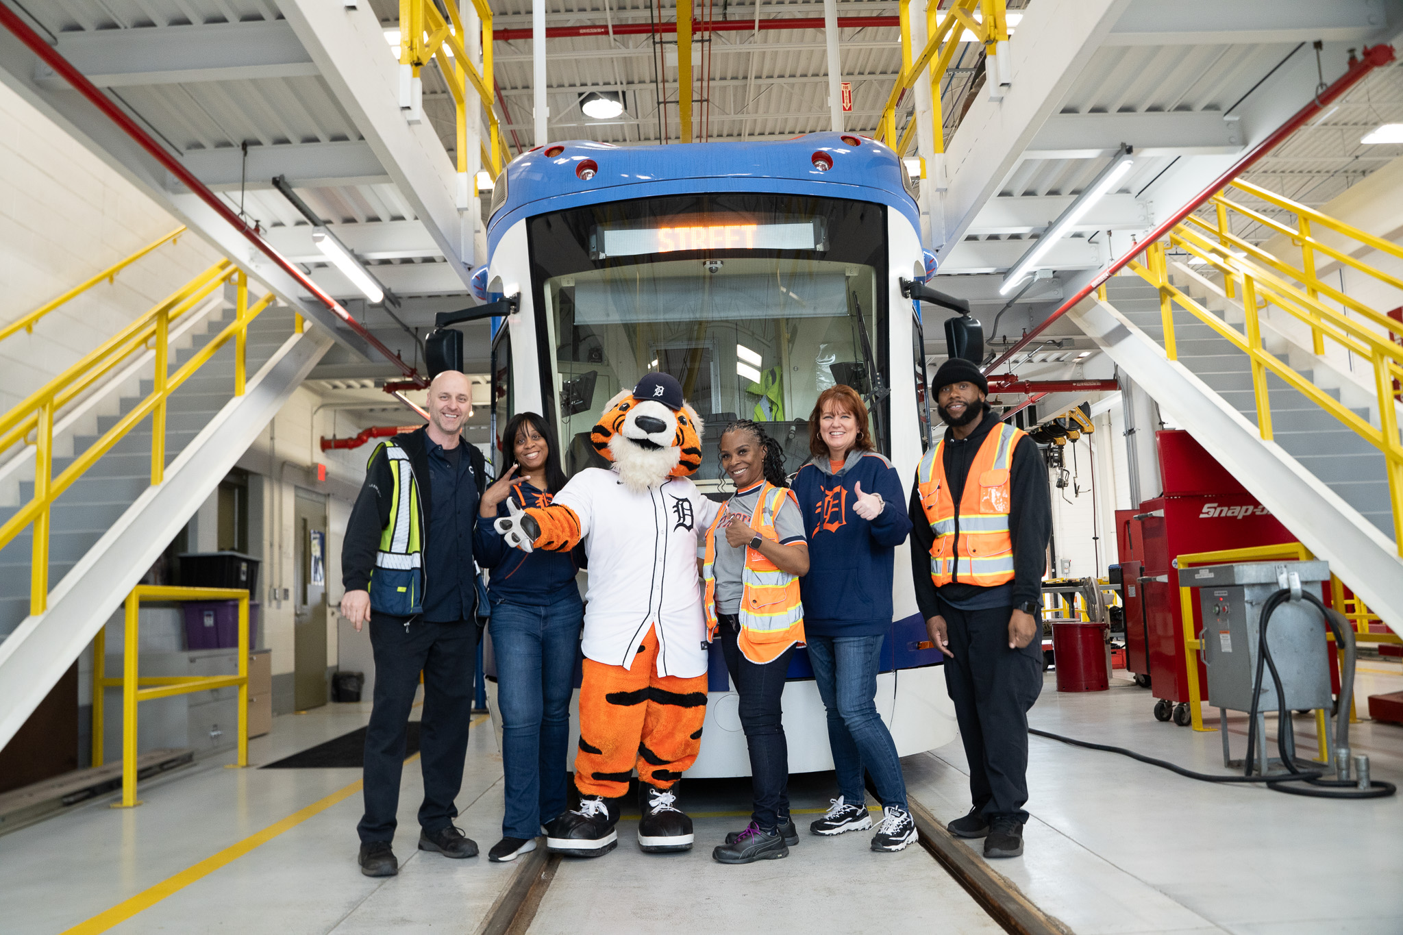
UPCOMING ITEMS
April
Federal Funding Split
Strategic Plan Approval
IT Managed Services Contract
May
Board Officer Slate
Strategic Plan Approval
Fiber Network Services Contract

