Slide 1
Executive Director’s Report
July 16, 2026

Slide 2
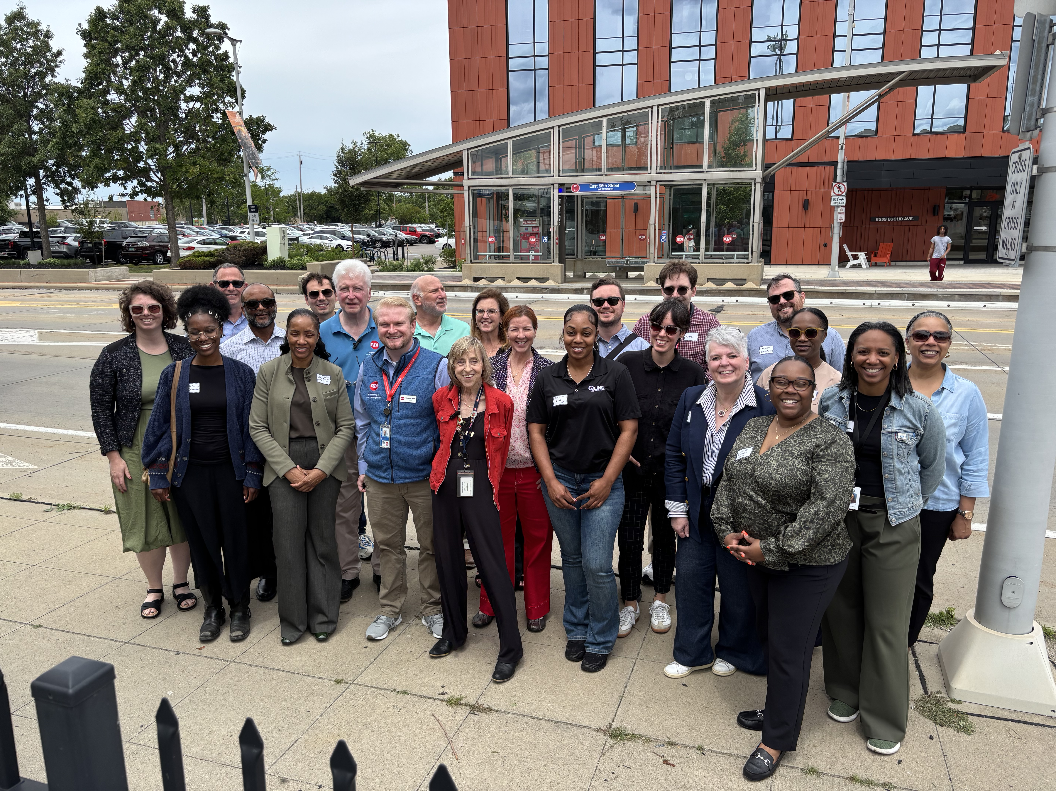
BIG NEWS: Cleveland Tour
On June 17th the RTA visited GCRTA and their highly successful HealthLine along the Euclid Corridor.
20 Attendees
RTA, SMART, DDOT, MDOT, City of Detroit, SEMCOG.
Key Takeaways
Land-use tools
Engagement through long-timescales
Demonstrated anchor for new and existing development

Slide 3
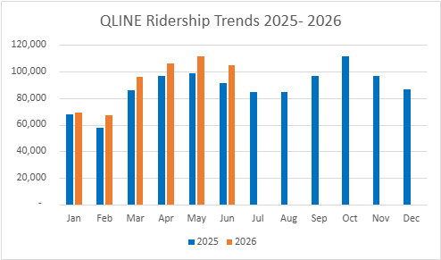
QLINE RIDERSHIP
2026 Goal | 1,159,198
YTD Target | 554,979
YTD Actual | 555,580
On/Off Target | +1.9%

Slide 4
QLINE PERFORMANCE
Metric | Target | Q1 | June
Completed Trips | Over 90% | 80% | 88%
On-time at Grand | Above 90% | 84% | 89%
On-time at Congress | Above 85% | 79% | 78%
On-time on alignment | Above 70% | 69% | 74%
Challenges:
Vehicle availability (long term rehab project underway)
Heat-related issues (batteries and traction power substations)
Solutions:
Proactive capital planning for vehicles
A/C unit rehabs
Inclement weather protocols

Slide 5
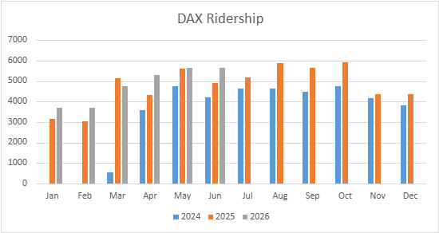
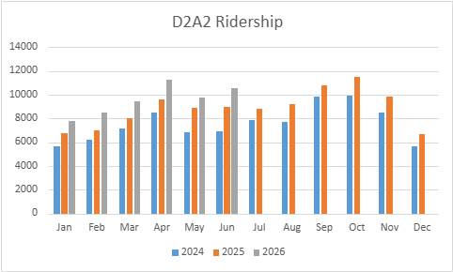
D2A2 and DAX RIDERSHIP
2026 Goal | 15% increase
D2A2 | 17%
DAX | 12%

Slide 6
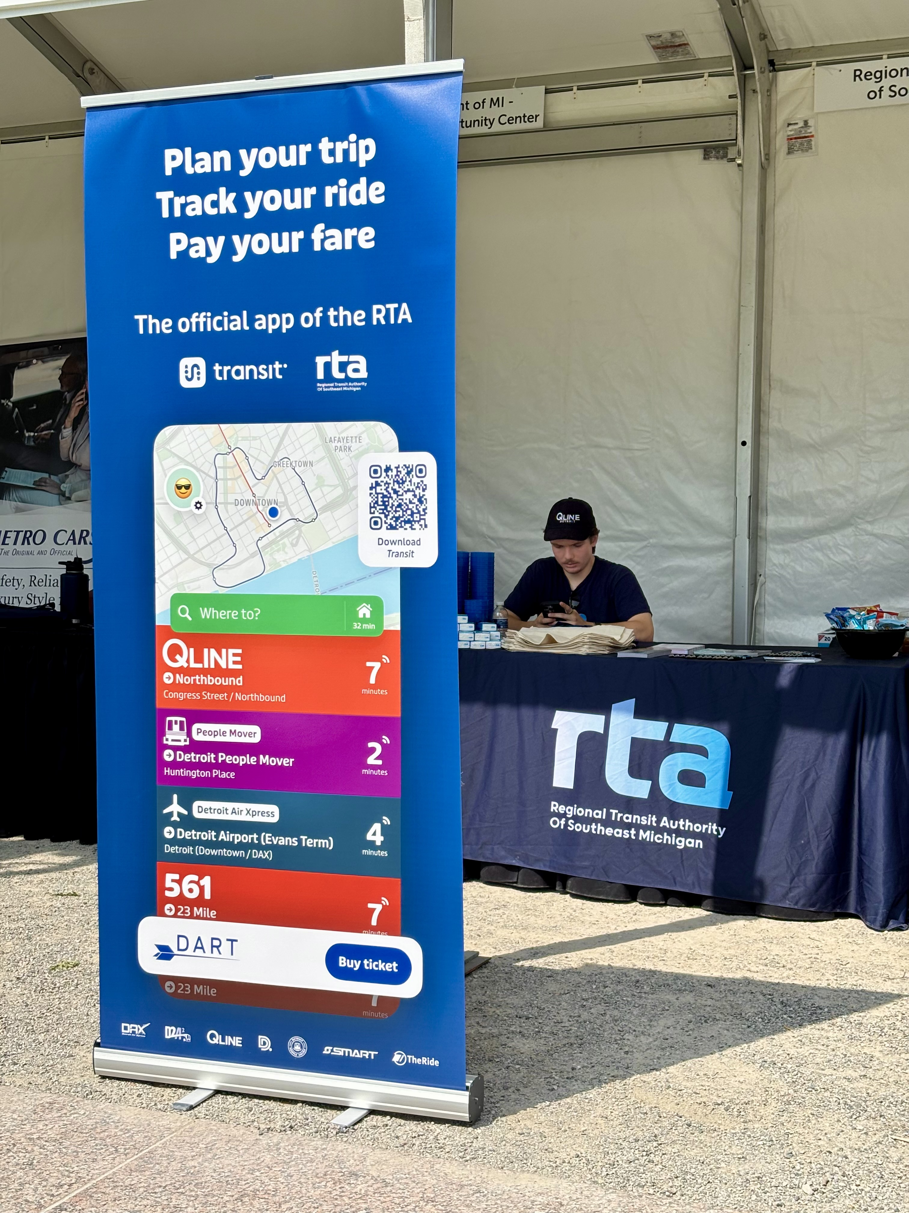

TRANSIT APP
Key Performance Indicators
Initial Focus - Downloads and Users (Goal: 20% increase year over year)
Other Indicators – Sessions, System Usage (trips/ratings), Mobile Payment Usage
Metrics (June 2026)
Users: 54,704 (+30% from June 2025)
Downloads: 5,482 (+5% from June 2025)
Sessions: 4.68M (+54% from June 2025)
Marketing
Summer Marketing Toolkit
sent to all providers
NEW Retractable Transit app banner
Notes:
Users: +3% from last month
Downloads: +7% from last month
Sessions: +1% from last month

Slide 7
STATE BUDGET
Waiting for Governor's Sign-off...
Local Bus Operating = $305M (30.5% distribution rate)
Infrastructure Projects Authority Fund = $65M
State Capital Match held steady

Slide 8
PROGRAM UPDATES
New State Infrastructure Funding: six applications submitted from the RTA region (RTA led a Downtown Detroit Transit Network application)
Procurements in Process:
IT Managed Services Provider
QL Direct Internet Access (Fiber)
QL Custodial Cleaning Services; Electrical Infrastructure; On-Call Electrical Services; Concrete Repair
Woodward Rapid Transit Study: Project Kick-off in late July
Mobility Wallet Pilot: Complete, update to Board in August

Slide 9
UPCOMING ITEMS
FY2027 Budget Development and Approval
Board Officer Slate
QLINE Capital Plan
IT Managed Services Provider Contract
QLINE Custodial Cleaning Services Contract
Public Transit Agency Safety Plan
Mobility Wallet Pilot Completion and Next Steps
Access to Transit Subrecipient Agreements
M4A Subrecipient Agreements

