Slide 1
Executive Director’s Report
August 20, 2026

Slide 2
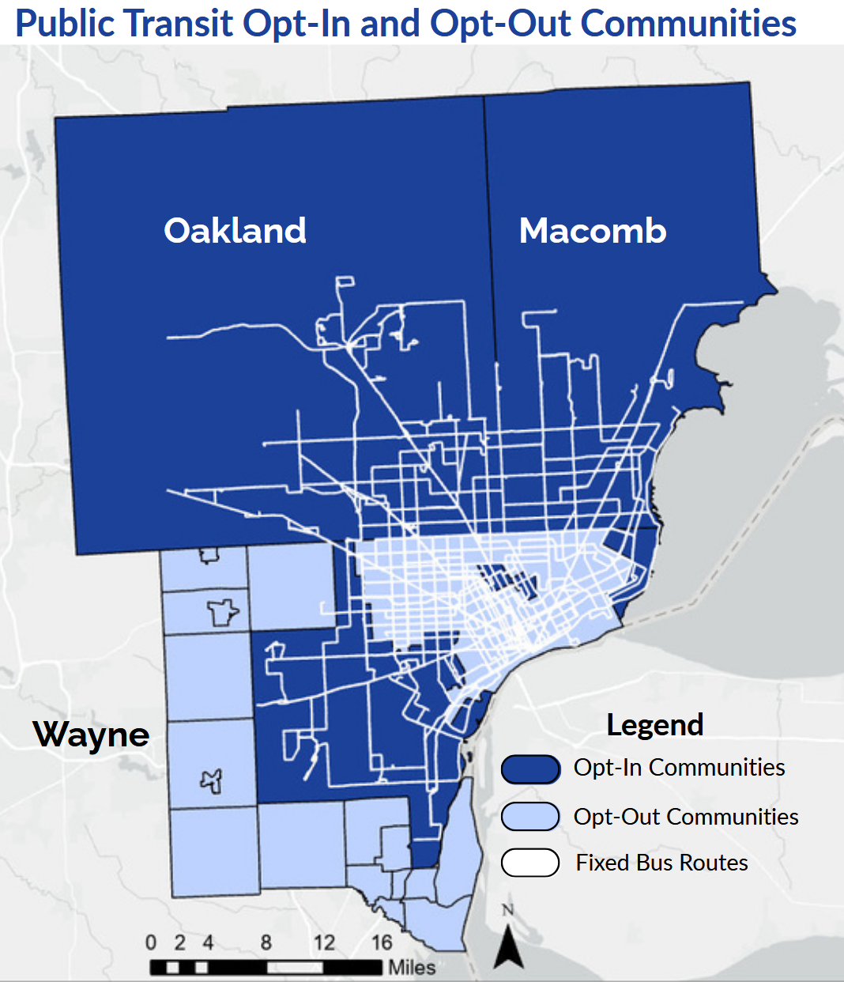
BIG NEWS: Wayne County Transit!
Wayne County passed a countywide transit millage by over 60%
.9831 mills over 10 years
~$57 million annually
Administered by the Wayne County Transit Authority
Revenue will be distributed to Wayne County, SMART, Detroit Department of Transportation (DDOT), and other community and regional transit providers

Slide 3
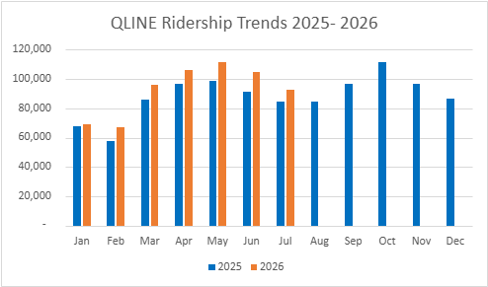
QLINE RIDERSHIP
2026 Goal | 1,159,198
YTD Target | 637,703
YTD Actual | 648,364
On/Off Target | +1.7%

Slide 4
QLINE PERFORMANCE
Metric | Target | Q1 | Q2 | July
Completed Trips | Over 90% | 80% | 88% | 70%
On-time at Grand | Above 90% | 84% | 89%
On-time at Congress | Above 85% | 79% | 78%
On-time on alignment | Above 70% | 69% | 74%
Challenges:
Vehicle availability
Adjusted schedule (3-4-3)
Solutions:
Proactive capital planning for vehicles
Manufacturer support
Recruiting

Slide 5
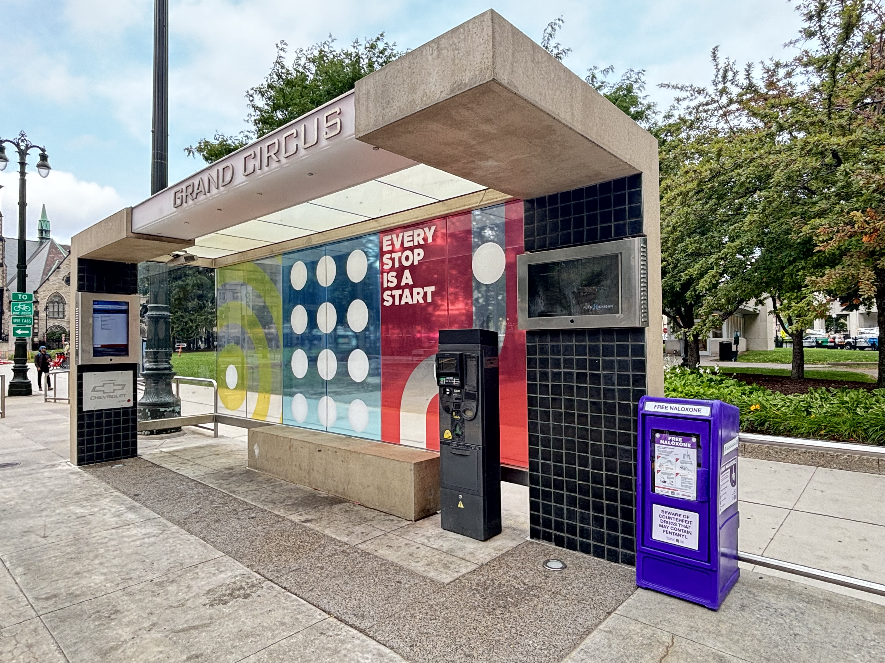
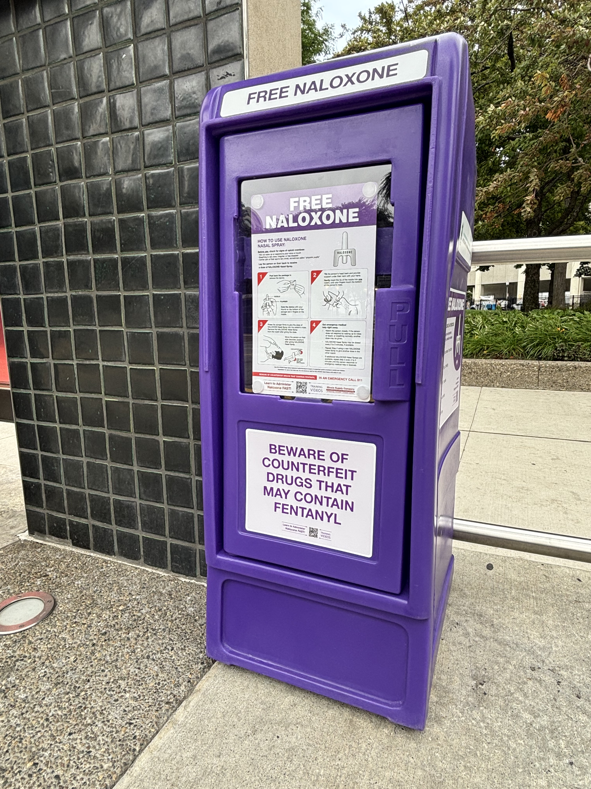
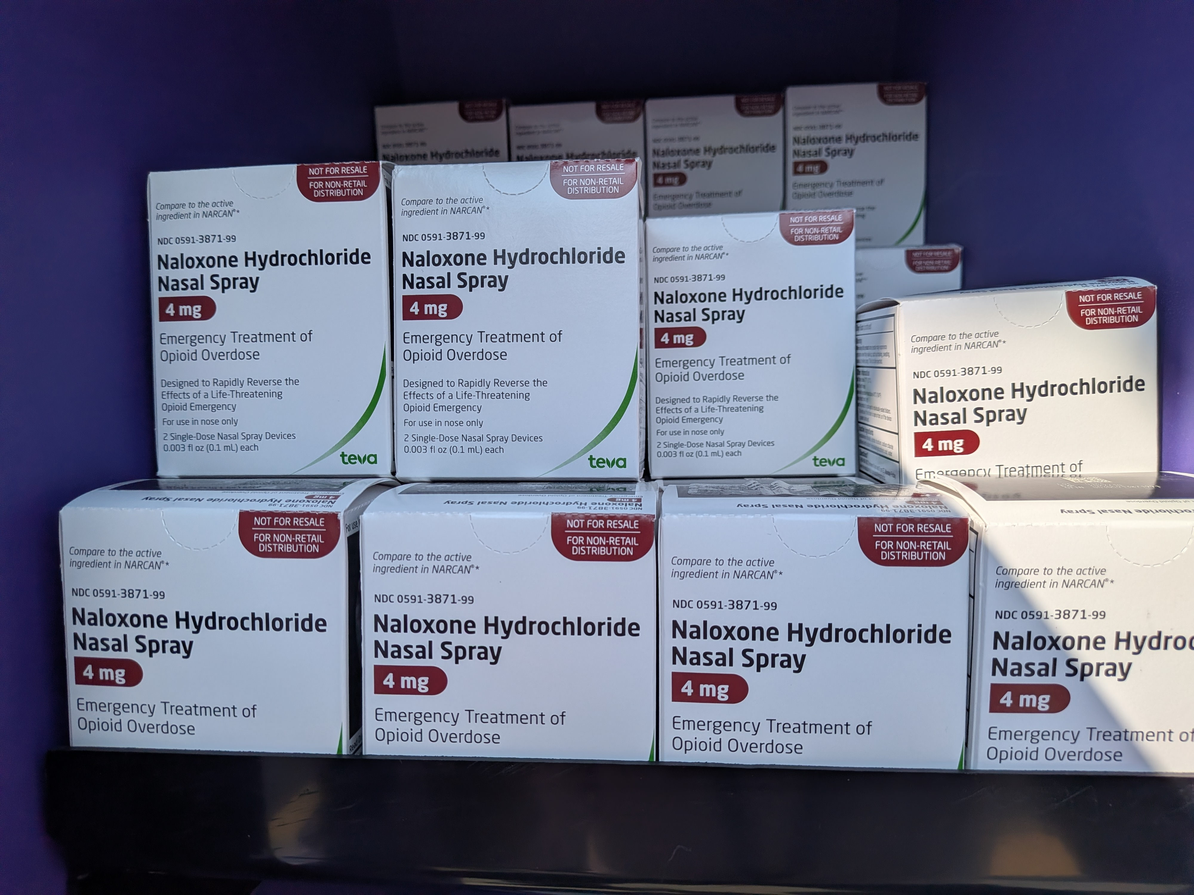
QLINE Harm Reduction Boxes
The City of Detroit Health Department has partnered with the RTA/QLINE to provide Harm Reduction Boxes at the QLINE's Grand Circus Park stations.
The Harm Reduction Boxes are filled with free naloxone (Narcan), Fentanyl drug test strips, and other life-saving resources. Harm Reduction Boxes are also located at DDOT's Rosa Parks & Blake Transit Centers.

Slide 6
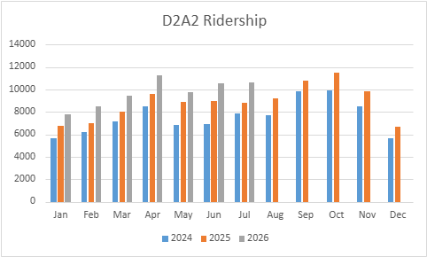
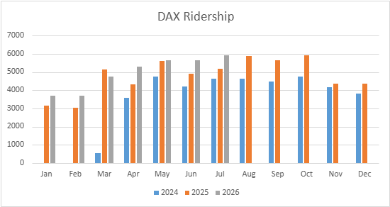
D2A2 and DAX RIDERSHIP
2026 Goal | 15% increase
D2A2 | 17%
DAX | 11%

Slide 7
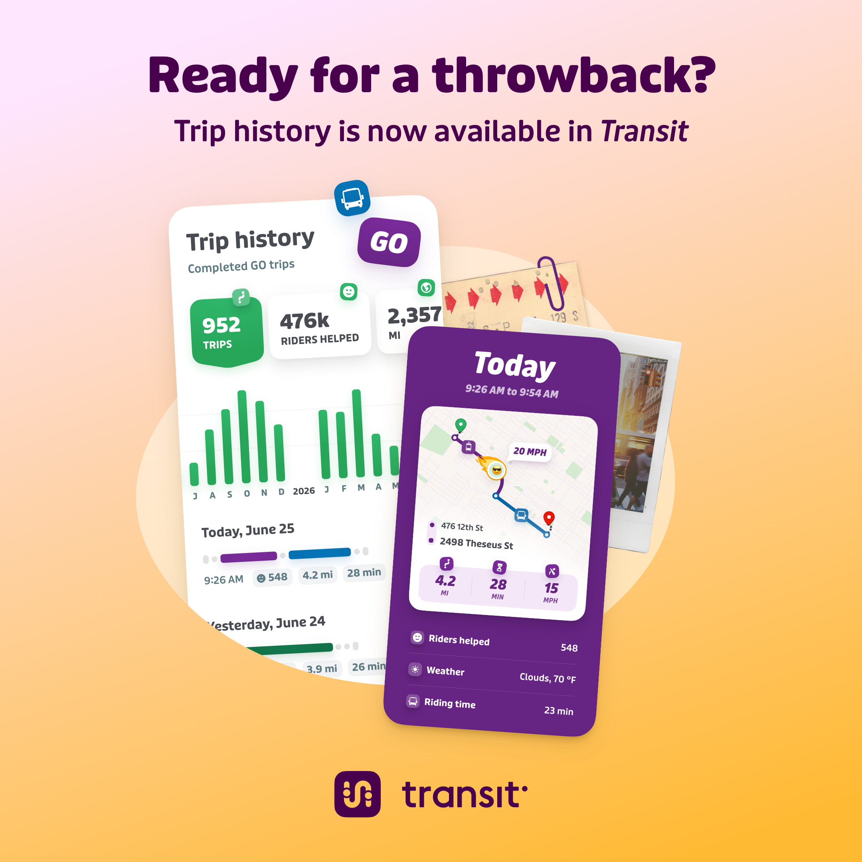

TRANSIT APP
Key Performance Indicators
Initial Focus - Downloads and Users (Goal: 20% increase year over year)
Other Indicators – Sessions, System Usage (trips/ratings), Mobile Payment Usage
Metrics (July 2026)
Users: 56,311 (+22% from July 2025)
Downloads: 8,303 (+23% from July 2025)
Sessions: 2.5M (+14% from July 2025)
Trips Planned: 622K (+32% from July 2025)
Marketing
New app features (fall '26): Trip History & Share ETA
Bi-monthly "Office Hours" for providers with RTA/Transit app staff
Notes:
Users: +3% from last month
Downloads: +7% from last month
Sessions: +1% from last month

Slide 8
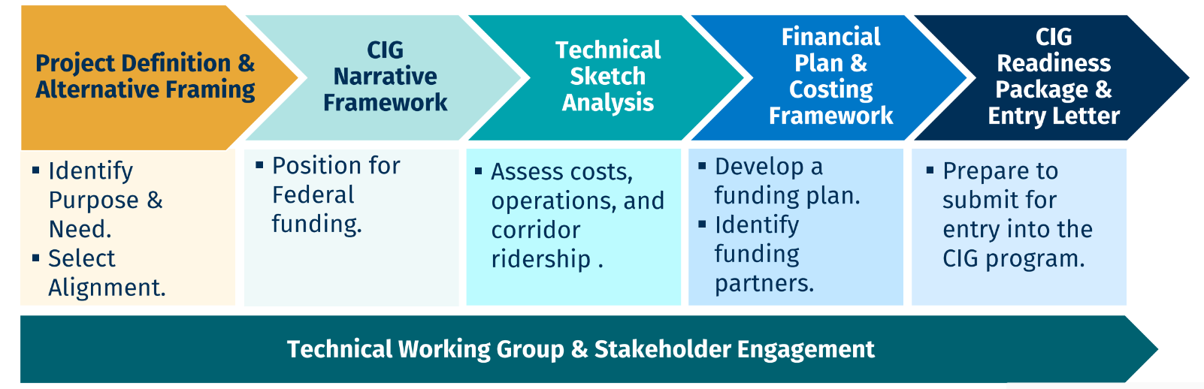
WOODWARD RAPID TRANSIT STUDY
Build upon prior planning to identify and build consensus around a transit-focused locally preferred alternative for Woodward Avenue that is ready for Project Development in FTA’s CIG Program

Slide 9
PROGRAM UPDATES
Access to Transit Projects: finalizing 60% design, developing subrecipient agreements (Dearborn, Detroit, Pittsfield, Southfield, Warren)
Highway Express Bus Study: initial network shared with providers, developing a deeper transit propensity analysis (Board update in October)
Procurements in Process:
IT Managed Services Provider
QL Direct Internet Access (Fiber)
QL Custodial Cleaning Services
Office Space: conducting two site visits (Downtown and New Center)

Slide 10
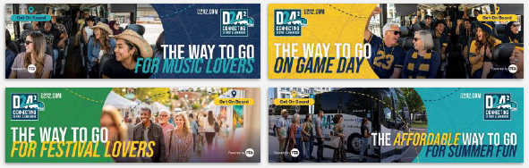
EXTERNAL AFFAIRS UPDATES
Social Media Influencer Collaboration
Contracted influencer (Christophe Kyle/@enjoymotorcity) to promote DAX on social media
Performance:
  Views: 193K
  Engagements: 17.5K (tons of positive comments about the service!)
  New Followers: 116
We're APTA AdWheel Grand Award Winners
The RTA has been awarded a top honor for our marketing campaign to increase QLINE ridership. We will receive the award at the annual APTA Conference in October.
Digital Billboard & Radio Advertising Metrics
D2A2 Digital Billboard (started 7/13):
  Impressions: 460,363
RTA Radio Ads (started 7/13):
  Impressions: 521,499
RTA Streaming Ads (started 8/12):
  Impressions: 29,428
  Clicks: 387 (1.32% click through rate)

Slide 11



UPCOMING ITEMS
FY2027 Budget Approval
Board Officer Slate
IT Managed Services Provider Contract
QLINE Custodial Cleaning Services Contract
Access to Transit Subrecipient Agreements
M4A Subrecipient Agreements
Highway Express Bus Final Report

