Slide 1


Ann Arbor Area
Transportation Authority
Update for the Board of the RTA
February 2026
Update for the Board of the RTA
February 2026
Matt Carpenter, CEO TheRide
Matt Carpenter, CEO TheRide

Slide 2

Ann Arbor Area Transportation Authority (TheRide)
Serve Ann Arbor & Ypsilanti area
103 buses, 31 paratransit, + contracted
Annual Trips
  Bus: 5.33 million
  Para: 91,000
324 FTEs
2

Slide 3
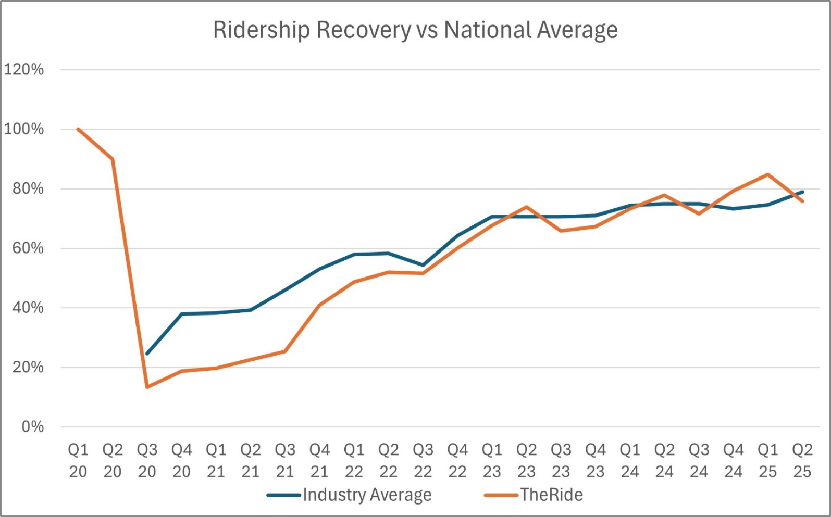
Local Ridership Trends
3

Slide 4
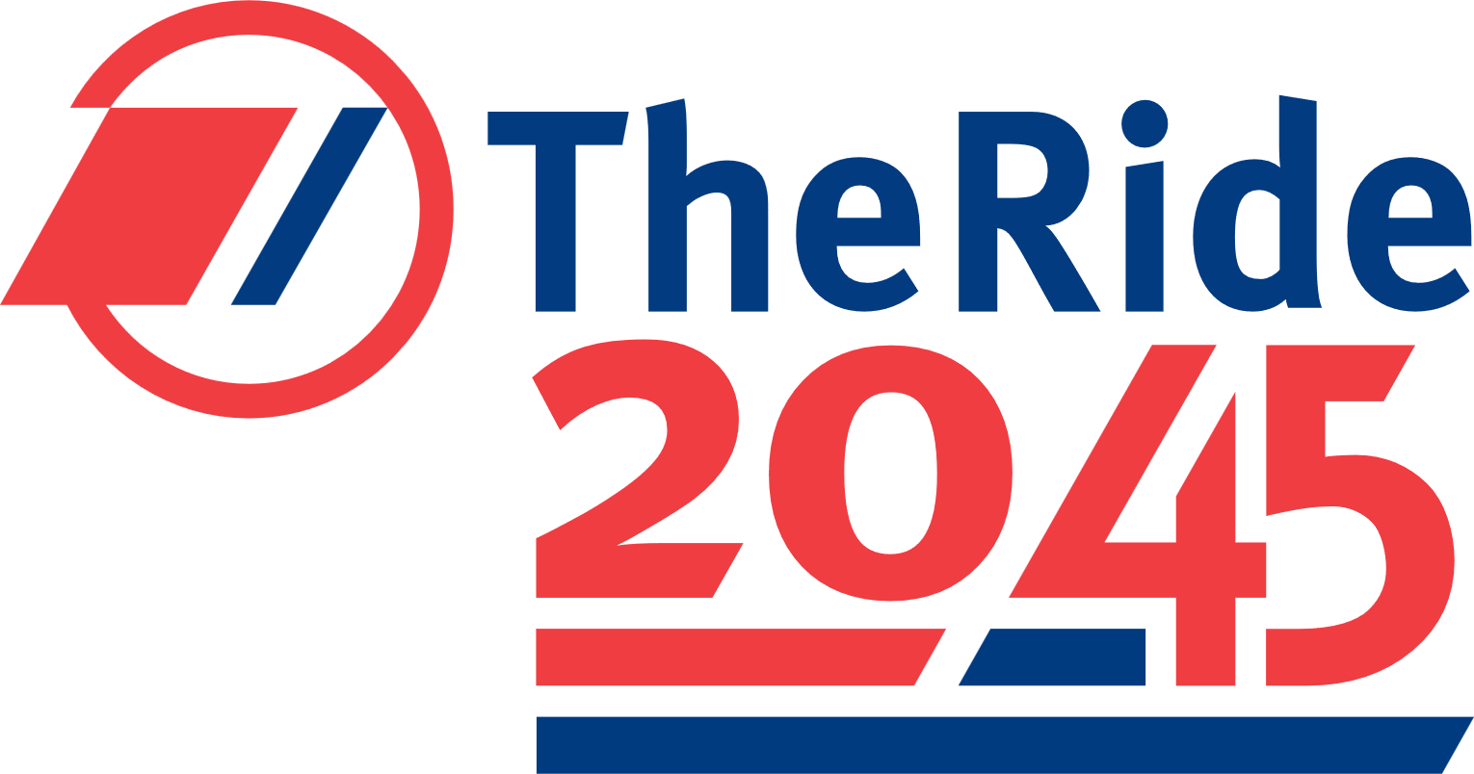
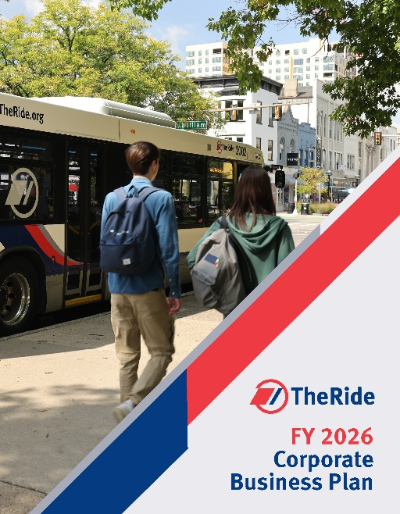
Recent Progress
Low-No Grant Award (2024)
Ypsilanti terminal project (2023-2028)
Millage Win (2022)
2045 Long-Range Plan (2022)
AdWheel Award (2026)
AAATA Business Plan Available
4

Slide 5
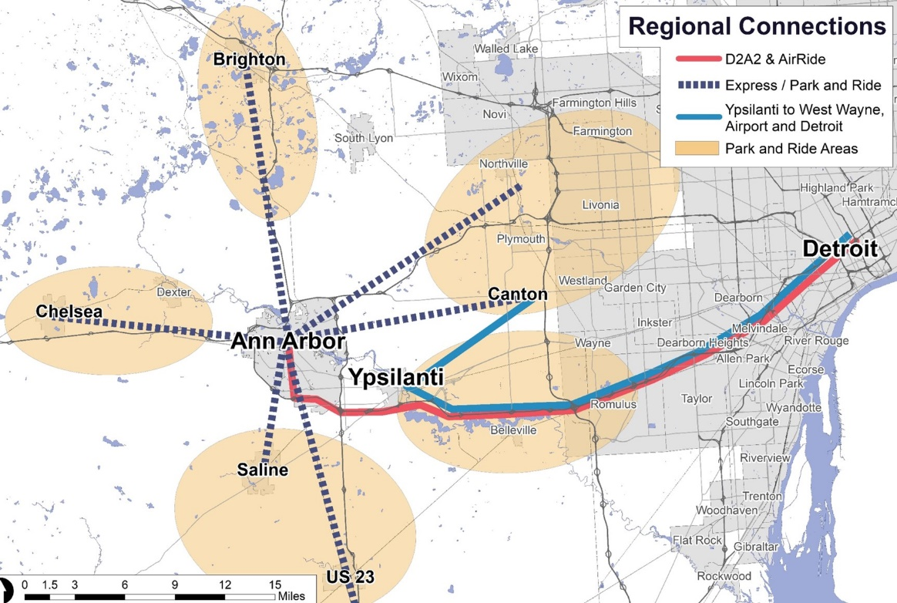
Regional Park and Ride
New State Infrastructure Fund
Uses D2A2/DAX-style buses to service large park n ride lots.
Ann Arbor: 80,000 daily commuters
5

Slide 6
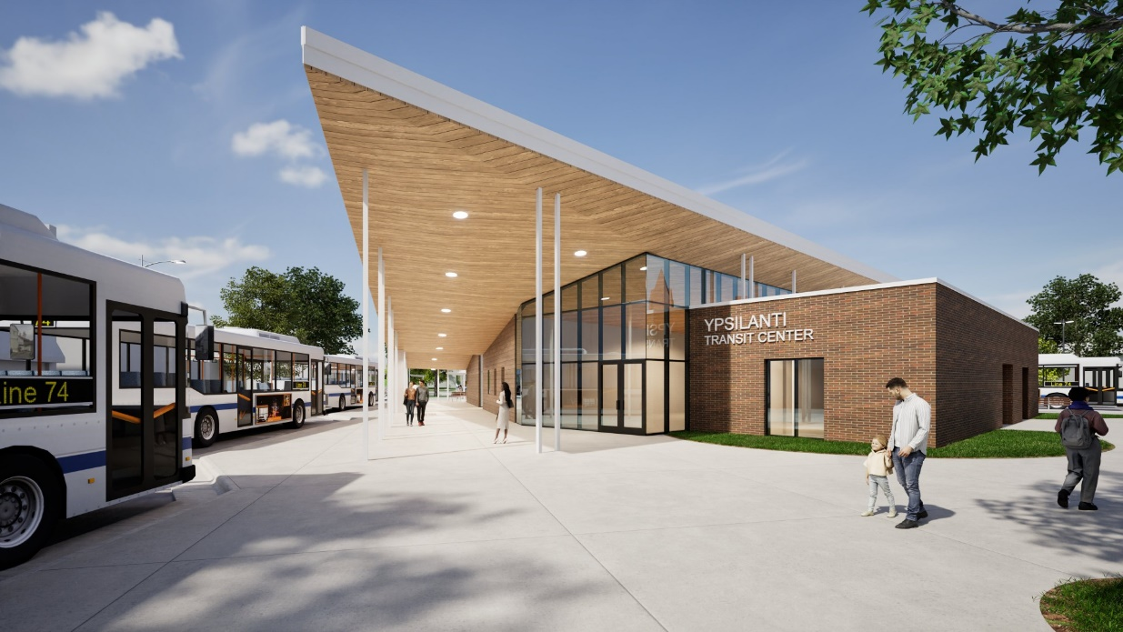
Capital Project Spotlight
Ypsilanti Transit Center
New bus terminal for Ypsilanti
Planning (2023-2026) Construction 2026-2027Opening 2028/2029
Anticipated cost ~$20m
$8.1m in CDS ($300,000 for planning (Sen Peters), $7 million for construction (Rep Dingell), $750k for security upgrades (Sen. Slotkin and Peters)
6

Slide 7
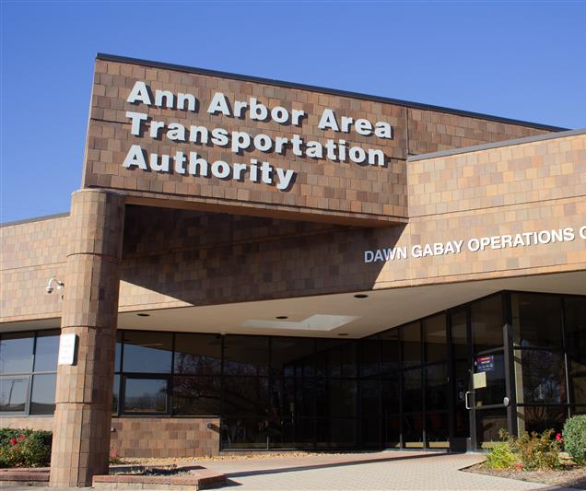
Bus Facilities & Bus Garage
Existing operations center is 40 years old
Looking at expansion options/new facility
Consultant hired, study underway
7

Slide 8
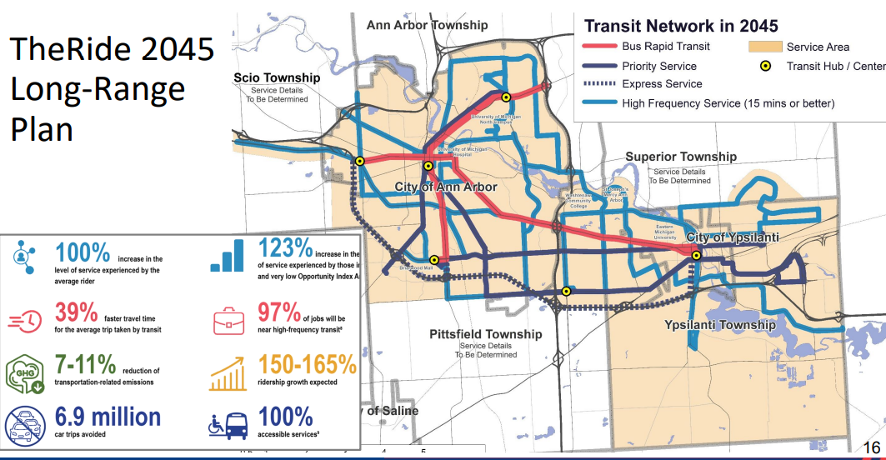
Bus Rapid Transit
BRT key part of TheRide 2045
MDOT M-17 PEL suggested dedicated bus lanes on E Washtenaw Ave
State Street bus lane pilot near central campus up and running.
8

Slide 9
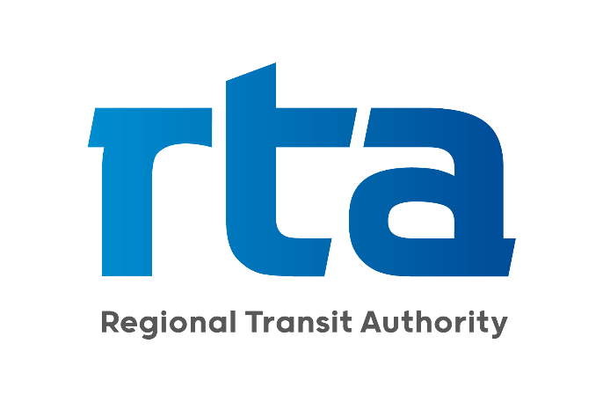

Closing
Delivering on Promises
Taking steps to make Plans into Realities
Partnership with RTA
9

Slide 10
Ann Arbor Area
Transportation Authority
Update for the Board of the RTA
February 2026
Update for the Board of the RTA
February 2026
Matt Carpenter, CEO TheRide
Matt Carpenter, CEO TheRide

