Slide 1
Executive Director’s Report
February 19, 2026

Slide 2
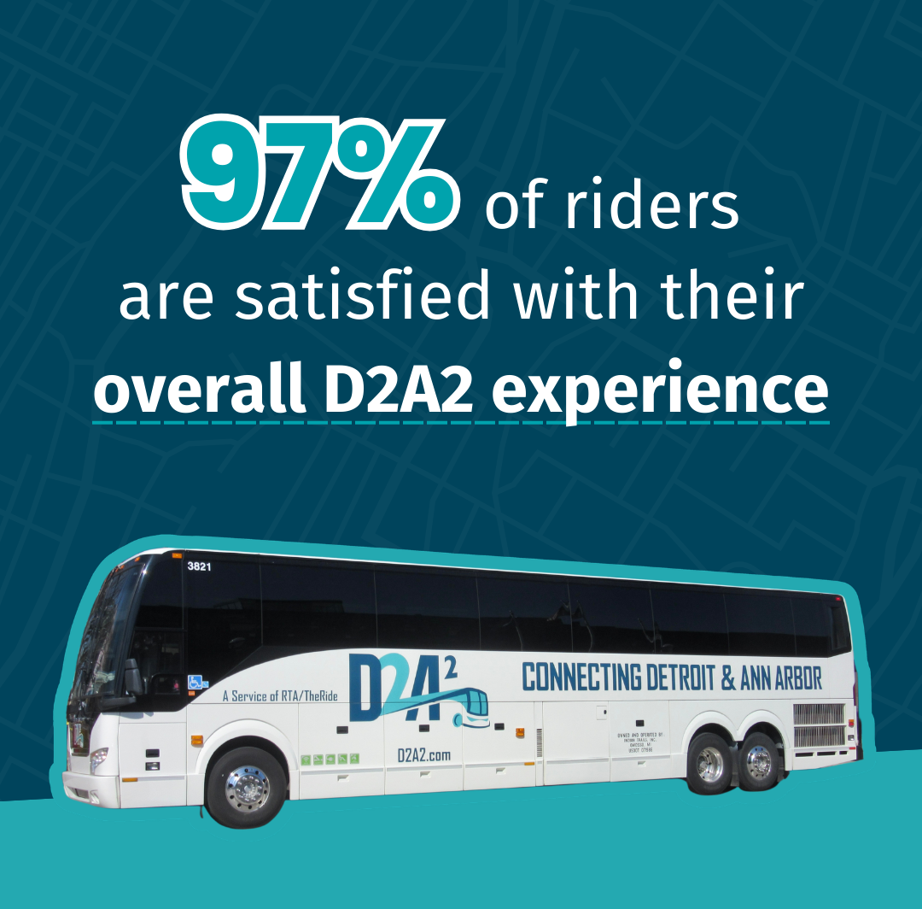

BIG NEWS

Slide 3
TARGETS FOR 2026
Increase QLINE ridership by 8% (100k increase)
Increase D2A2/DAX ridership by 15%
Increase Transit App users by 20%
Continue to Increase the Value of All RTA Programs
  Complete the Strategic Plan
  Complete the Mobility Wallet Pilot and Determine Next Steps
  Advance Key Mobility4All Recommendations
  Complete Environmental and Design of Five Access to Transit Projects
  Establish a Regional Corridor Program

Slide 4
QLINE RIDERSHIP
2026 Goal | 1,159,198
YTD Target | 74,423
YTD Actual | 69,113
On/Off Target | -7.1%

Slide 5
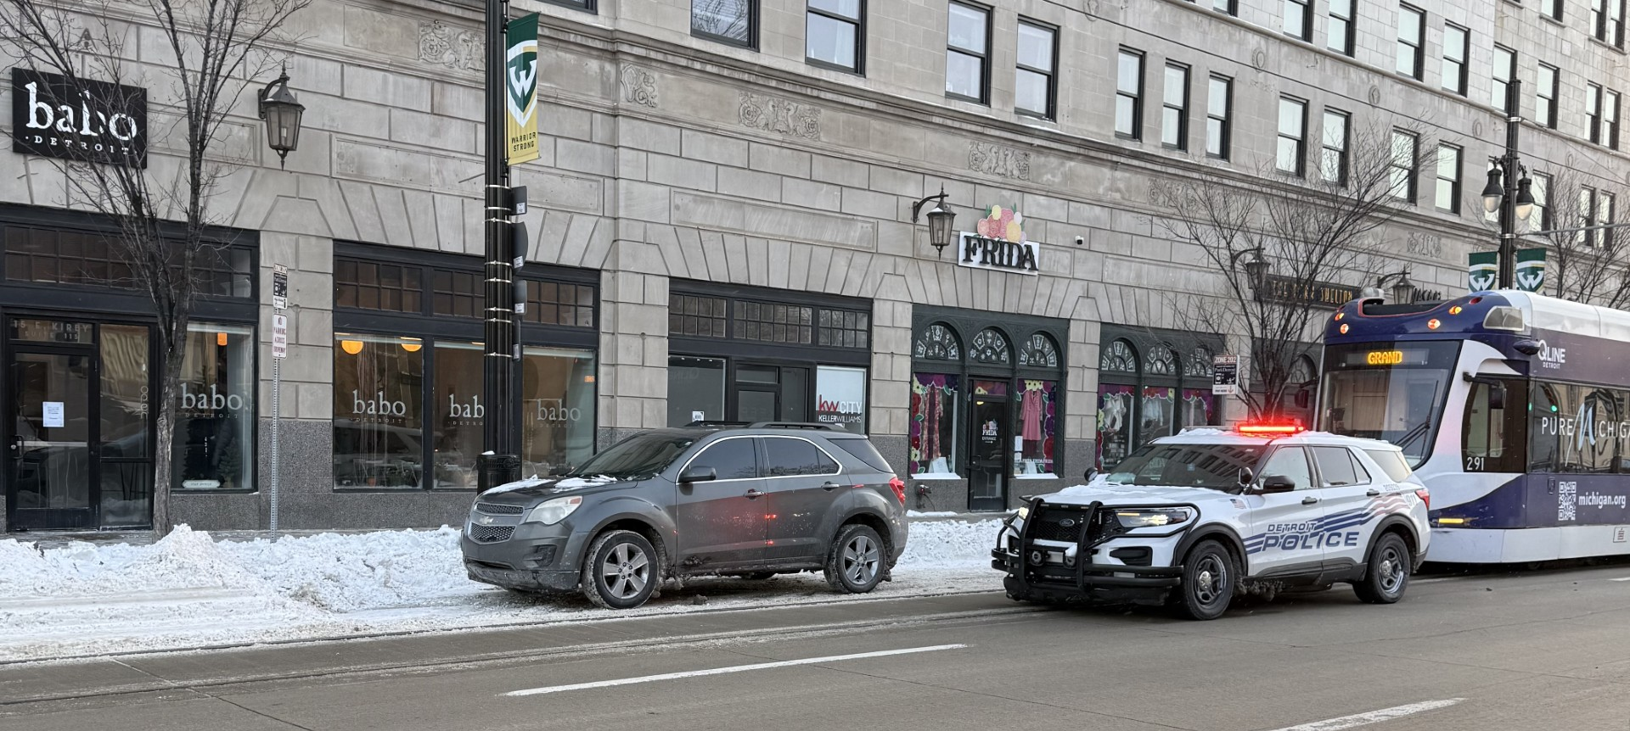
QLINE PERFORMANCE
Challenges:
Blockages!!!
Signal aspects and switches need improved maintenance
Station monitors need to be updated
Metric | Target | YTD
Completed Trips | Over 90% | 80%
On-time at Grand | Above 90% | 80%
On-time at Congress | Above 85% | 71%
On-time on alignment | Above 70% | 61%
Solutions:
MDOT and City coordination
Signal and switch maintenance contracts are up for renewal
New station monitor equipment is on the way
156 incidents, 60 hours of delay

Slide 6
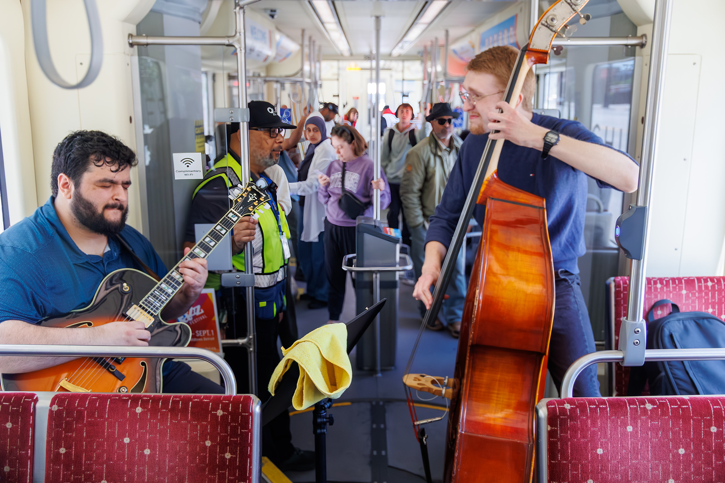
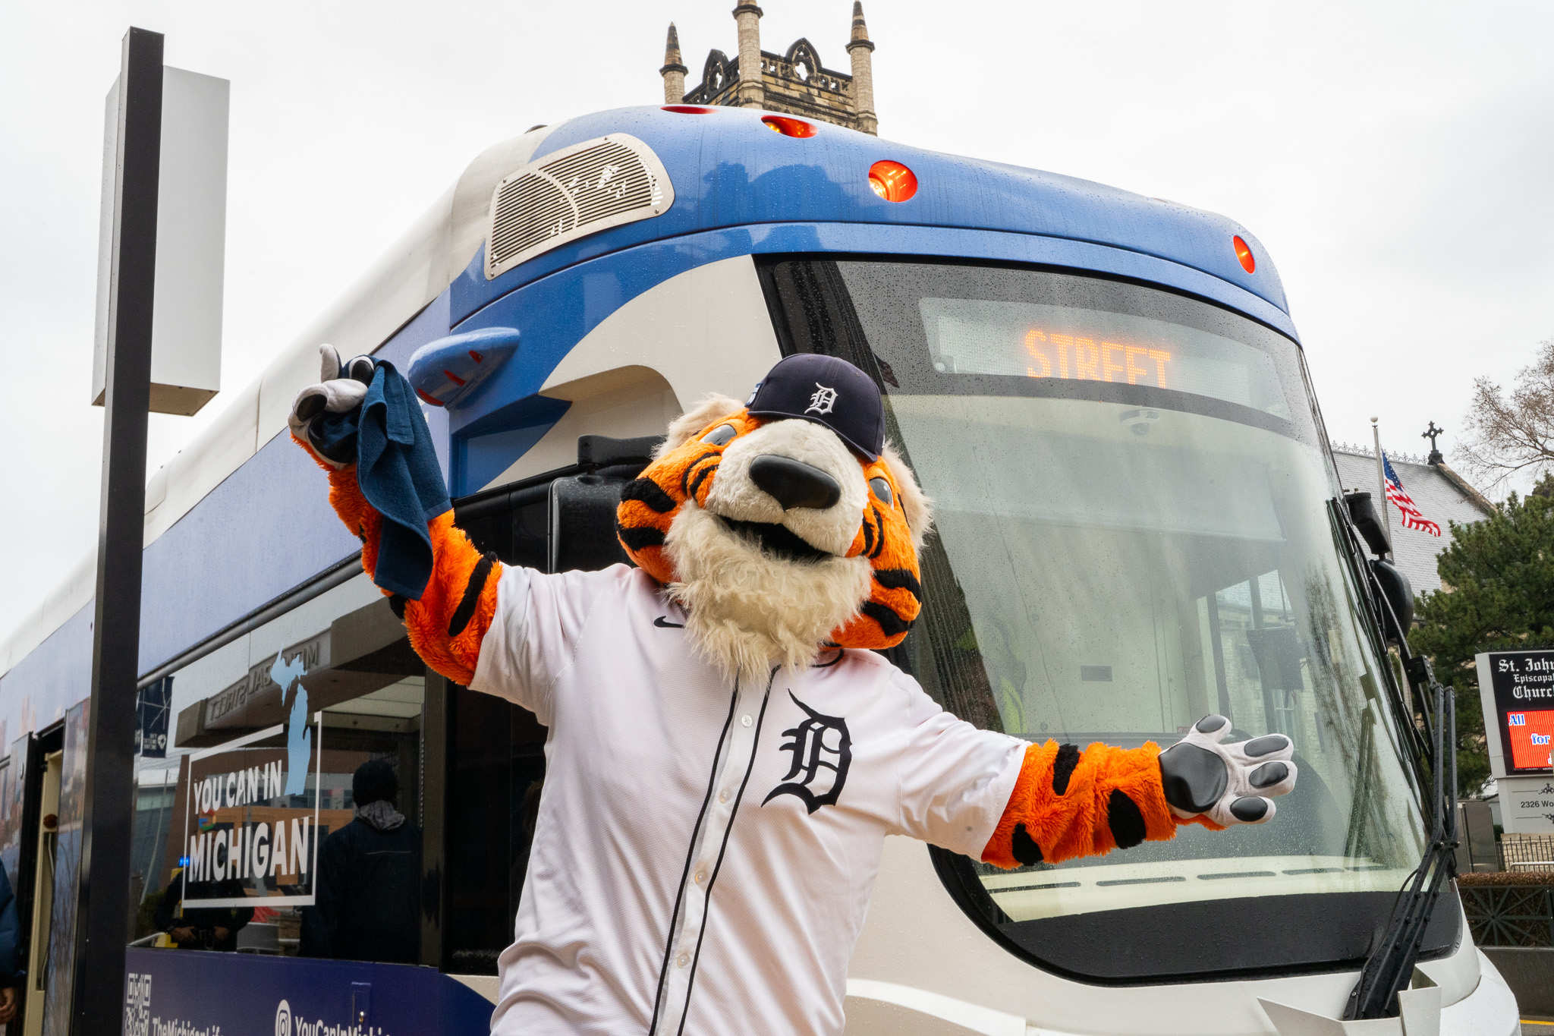
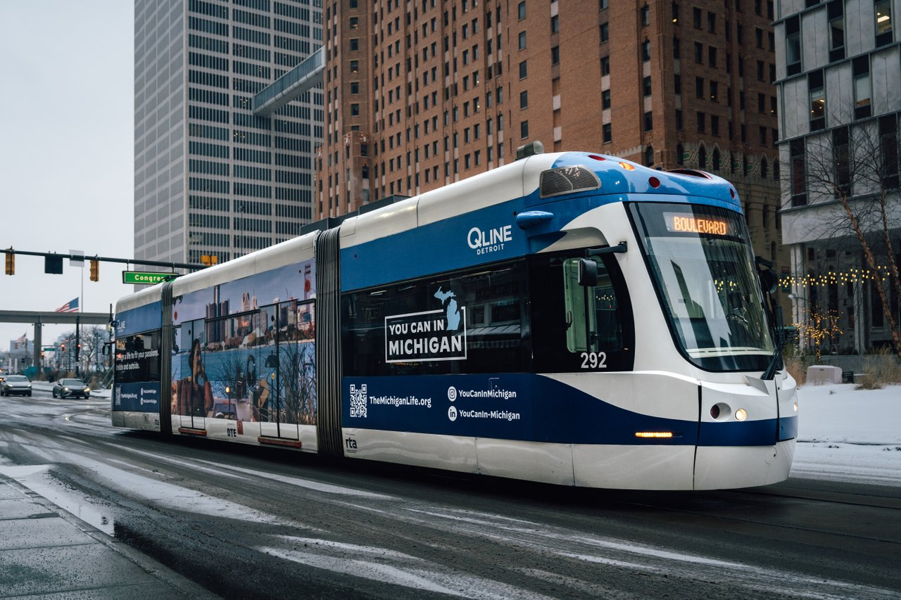
QLINE MARKETING
Campaign Planning
New team started in Jan
Full refresh of the marketing theme and direction
Opportunity to rebrand stations
Customer satisfaction over 80% (October survey)
MEDC Partnership through December 2028
Streetcar Wraps
Station Monitors
Interior Signage

Slide 7
D2A2 and DAX RIDERSHIP
2026 Goal | 15% increase
D2A2 | 15%
DAX | 17%

Slide 8


TRANSIT APP
Key Performance Indicators
Initial Focus - Downloads and Users (Goal: 20% increase year over year)
Other Indicators – Sessions, System Usage (trips/ratings), Mobile Payment Usage
Metrics (Jan 2026)
Users: 46,662 (+21% from Jan. 2025)
Downloads: 3,900 (-5% from Jan. 2025)
Royale Users thanks to Transit partnership: 34K+
Average Rating: 4.6/5
Marketing
GO trips increased 54% with campaign
Vehicle/Stops/Station Decals
Rider Education
Notes:
Downloads were a negative percentage for January, in part due to the bitter cold and ice all ridership was down. Transit notes ridership across the board is usually less in January

Slide 9
PROGRAM UPDATES
Strategic Plan Board discussions will be scheduled for March
Regional Capital Program and Federal Funding Action scheduled for March/April
Finalist Access to Transit Sites Identified: Southfield, Detroit, Warren, Pittsfield Township, and Dearborn
$2.6 Congressionally Directed Spending Request for Woodward Dedicates Lanes (Peters), included in federal spending package
First full NTD submitted to FTA

Slide 10
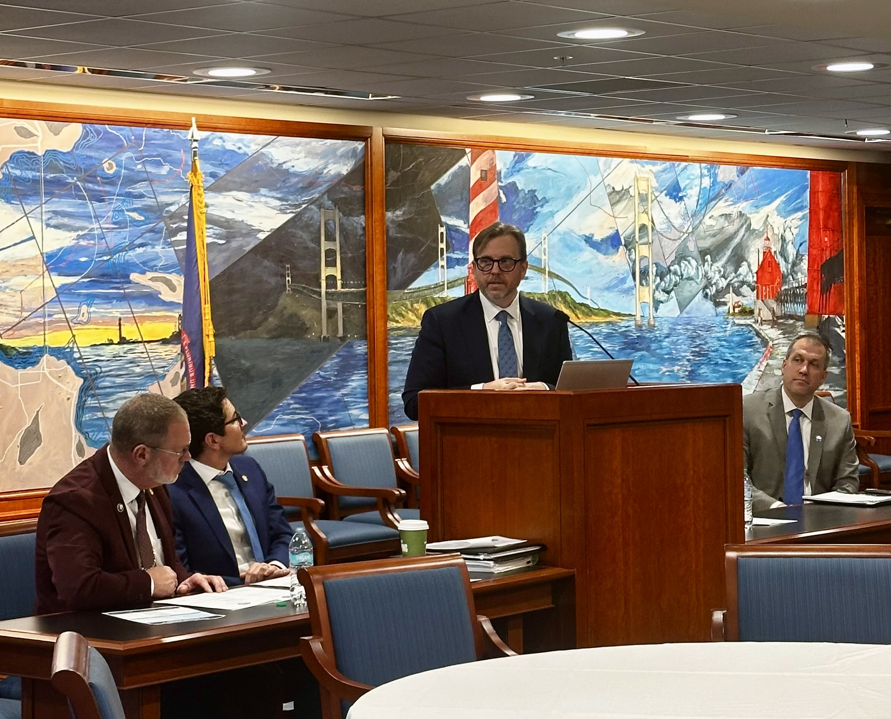
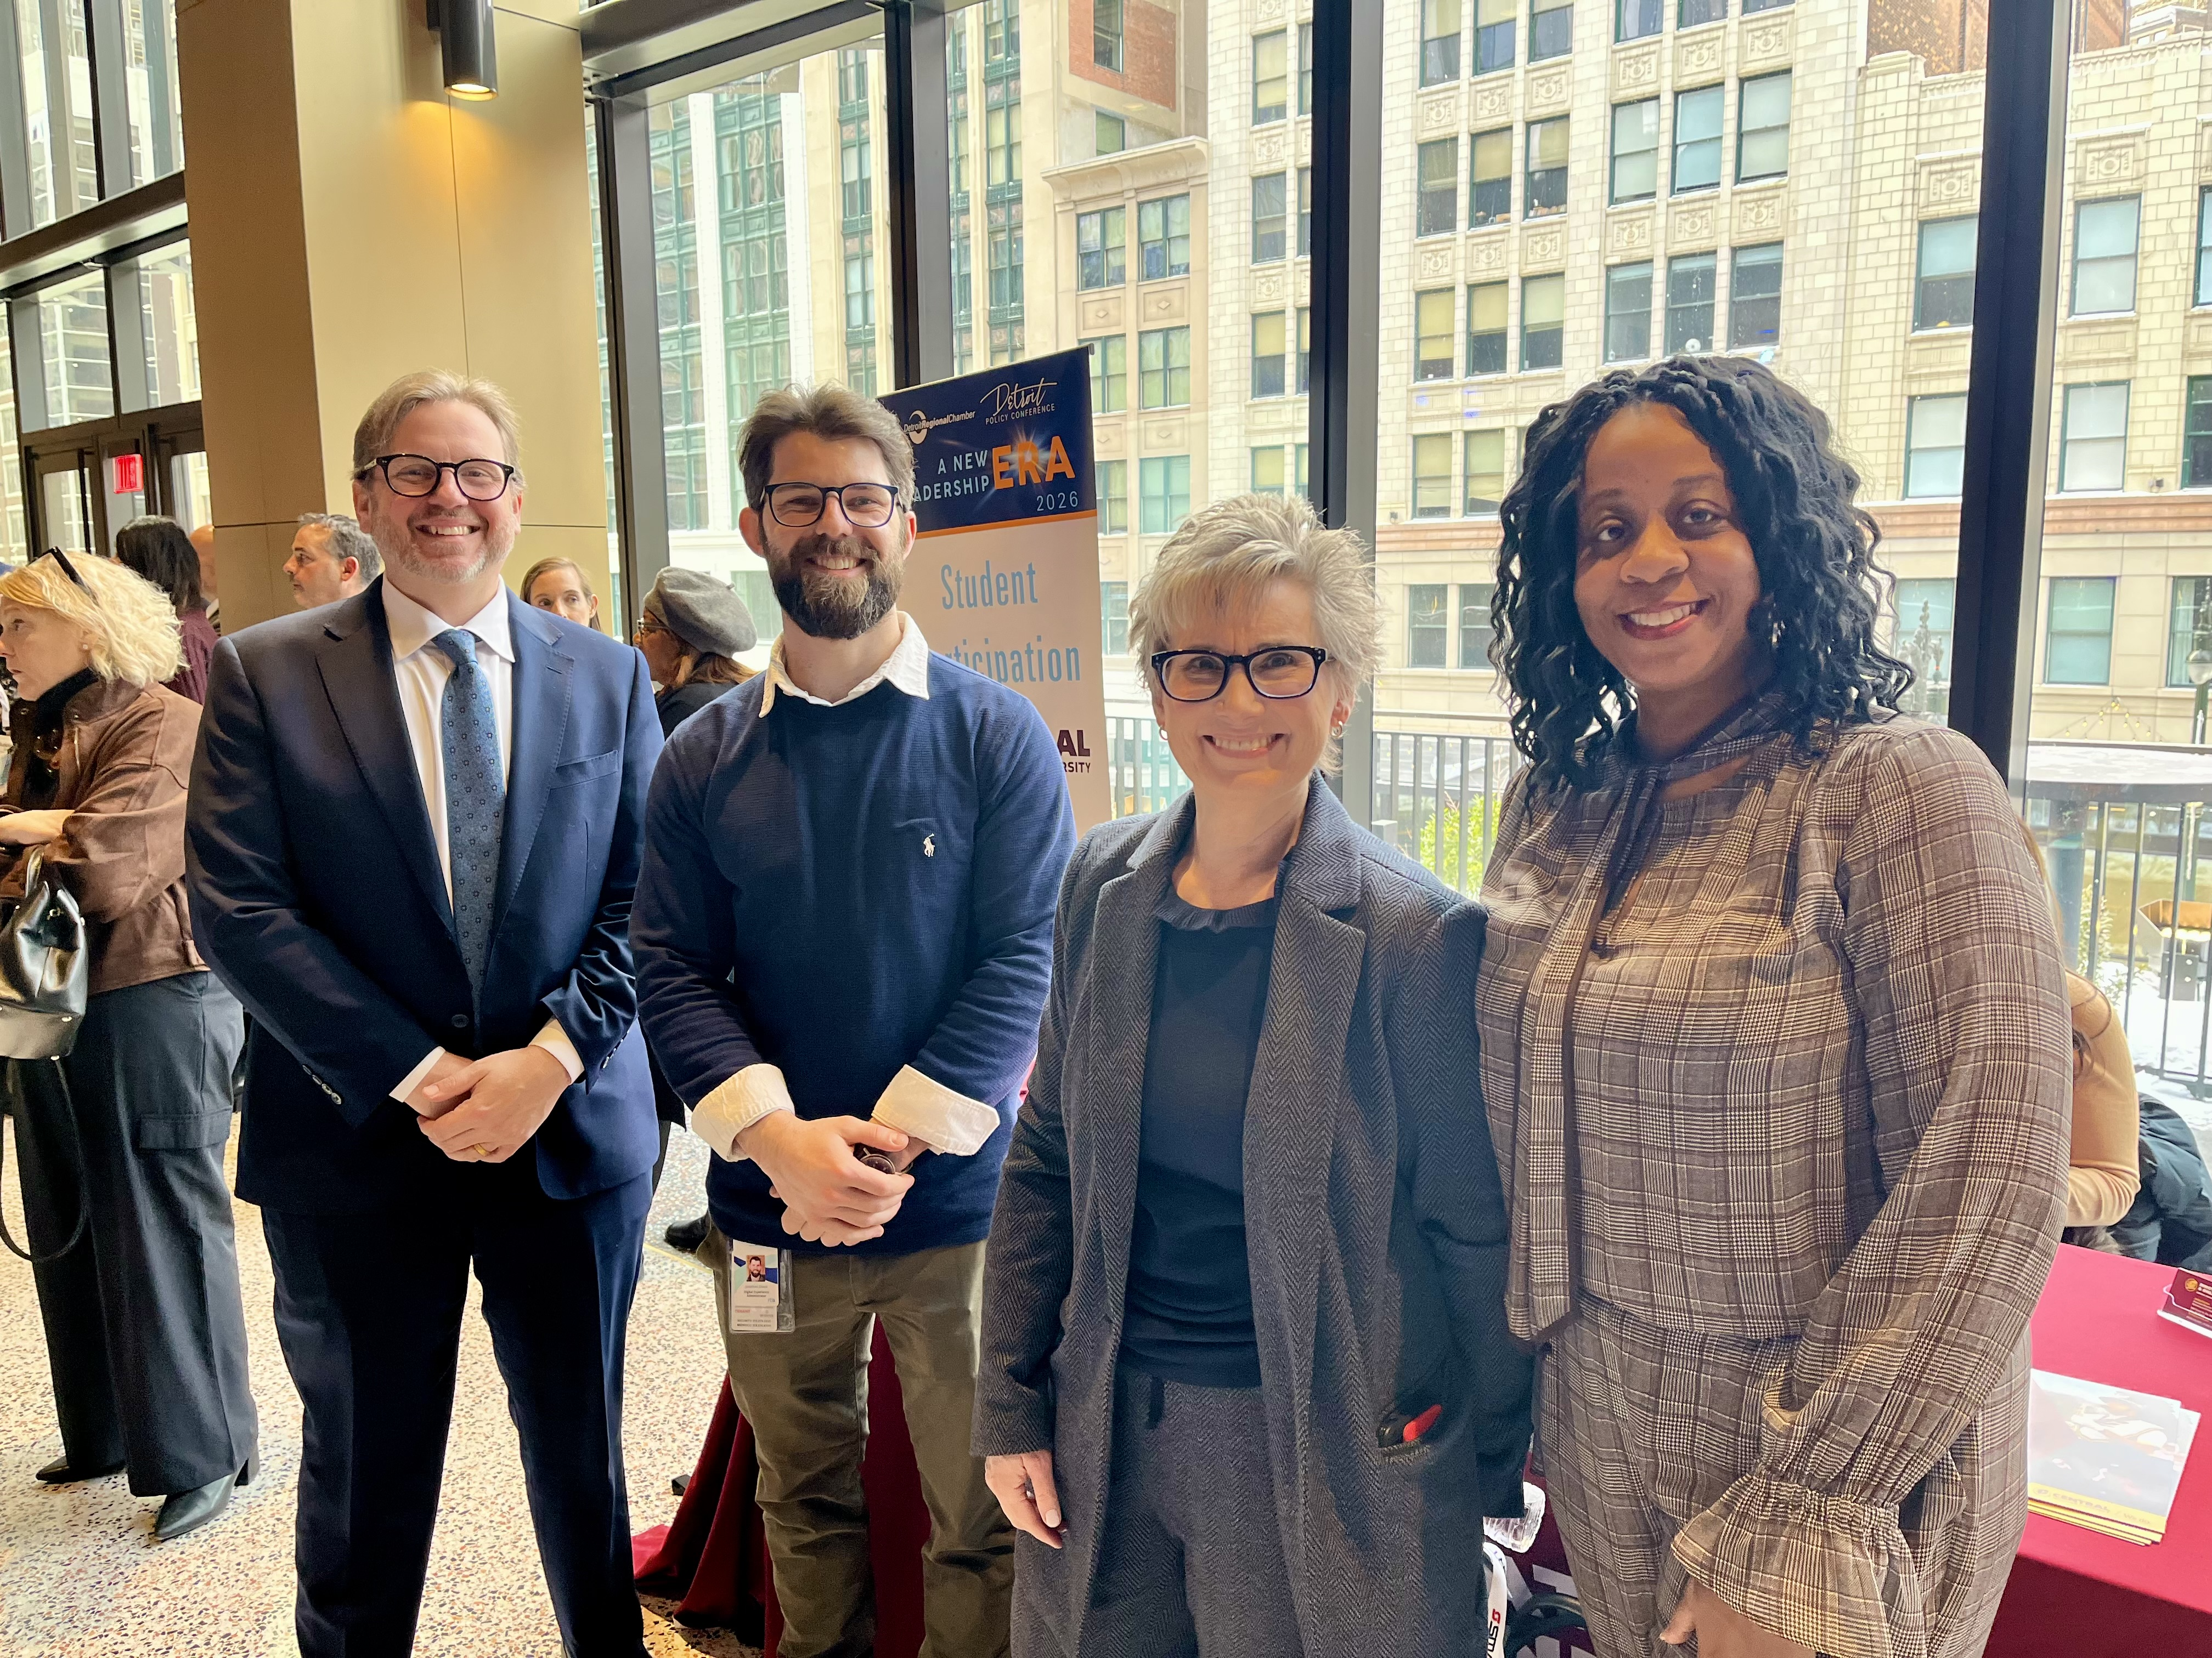
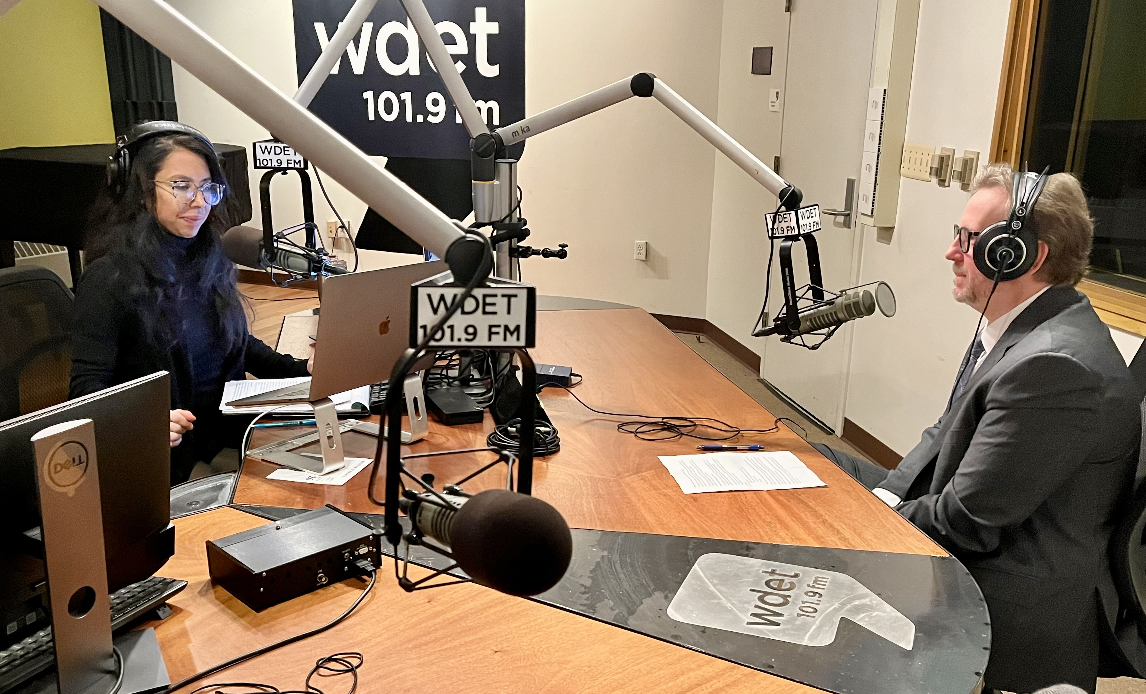
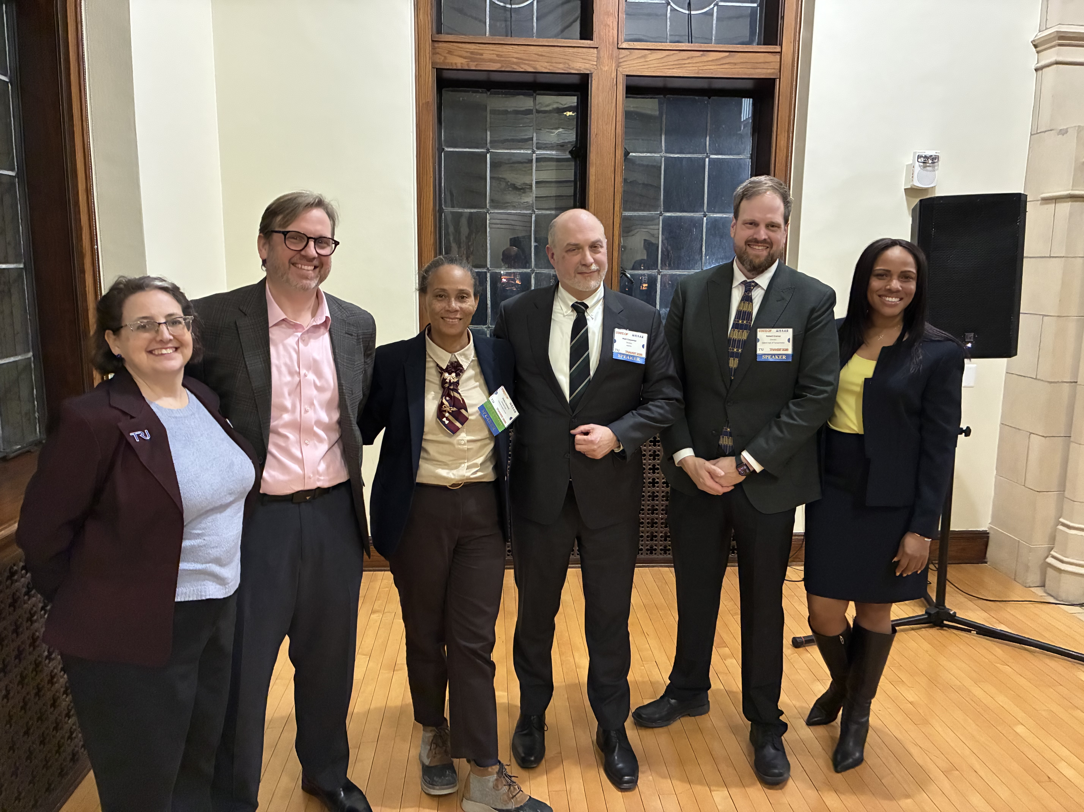
UPCOMING ITEMS
March
State Funding Approval (Providers)
Financial Audit
Provider Presentations
Legal and IT Managed Services
Contracts
April
Federal Funding Split
Strategic Plan Approval
*Conflict of Interest forms

